Slide 1
Wellness Fund
Board work session
Nov. 6, 2019
AJ Diamontopoulos
Accountable Health Communities Manager

Slide 2
Background: Factors driving health outcomes
clinical care
10%
genes and
biology
10%
social and
economic factors
40%
social and
economic
factors
40%
physical
environment
10%
health
behaviors
30%
health
behaviors
30%

Slide 3
Background: the U.S. is an outlier

Slide 4
Background: Health-related social needs
Denver Regional Accountable Health Community
  began in May 2017
  $4.51 million in funding over five years from the Centers for Medicare and Medicaid Innovation
Purpose:
  identify and address the health-related social needs of Medicare and Medicaid beneficiaries to improve quality of care and reduce health care costs

Slide 5
IDENTIFYING THE CHALLENGES

Slide 6
Challenge: New health care initiatives
The establishment of several new health care initiatives will dramatically increase the number of referrals to community organizations, which are already at capacity.
Hospital Transformation Program
The former hospital provider fee is now the Colorado Hospital Transformation Program.
In 2019, it paid $407,091,481 to hospitals that demonstrated meaningful community engagement and health outcome improvements.

Slide 7
Challenge: New health care initiatives (cont.)
State Health Information Exchange (public-private partnership)
  Front Range: Colorado Regional Health Information Organization
  Western Slope: Quality Health Network
Colorado Office of eHealth Innovation
  $64 million in federal funds to plan and implement Colorado’s Health IT Roadmap
Medicaid payments
  some clinicians receive payments to identify social needs and refer patients to community-based services

Slide 8
Challenge: New health care initiatives (cont.)
Thrive by Kaiser Permanente
The Thrive Local network launched in summer 2019.
Within three years, it will be available to all of Kaiser Permanente’s 12.3 million members, as well as 68 million residents in the communities Kaiser Permanente serves.
Will increase referrals to community-based organizations.

Slide 9
Problem: Community organizations are at capacity.
Waiting lists: Most community organizations are at service capacity.
limited funding for community-based services (statewide, annual)
  $46 million spending on area agency on aging services
  $7.9 billion spending for Medicaid

Slide 10
Problem: Referrals alone don’t lower health care costs.
Community-based organizations need to engage with:
  the Colorado Hospital Transformation Program.
  the State Health Information Exchange.
  the State Medicaid Office.
  Kaiser Permanente and other insurance companies.

Slide 11
Potential Solution: Wellness Fund
Wellness Fund
  a DRCOG-led program designed to enable community organizations to supply services at the capacity needed
Responsibilities:
  convene stakeholders
  identify community services that have a positive effect on health care costs
  invest in the capacity of community services
  pay for the delivery of community services

Slide 12
Potential solution: Wellness Fund
Funding
DRCOG would like to see investments by the state and health care providers to support meeting the demand for these vital community services.

Slide 13
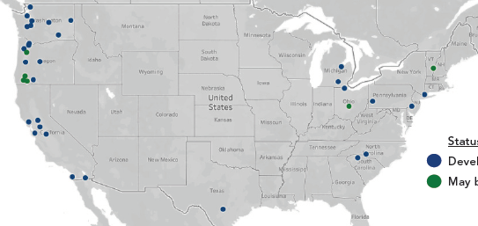
Similar initiatives (Source: Funders Forum on Accountable Health)
Washington state
Boise, Idaho
Imperial County, California
Status:
developing or implemented
conceptualizing

Slide 14
DRCOG’s efforts to date
attended a national event hosted by the Funders Forum on Accountable Health to learn about similar efforts
developed a strategy and action plan
met with the governor’s staff
  encouraged to meet with Colorado’s Medicaid director
met with staff from the Office of Saving People Money on Healthcare

Slide 15
QUESTIONS?
THANK YOU!
AJ Diamontopoulos
Manager, Accountable Health Communities
adiamontopoulos@drcog.org
303-480-6767
EO-PP-BW19AAAOPPORTUNITY-19-08-12-V3

