Slide 1
Small-Area Forecast
Working Group
December 7th, 2022
Andy Taylor, AICP
Manager, Regional Planning and Analytics
Zachary Feldman, Ph.D
Manager, Data Science and Analytics
Geoffrey Chiapella
Senior Planner, Data Science and Analytics
This meeting is being recorded

Slide 2
Agenda
Introduction
Small-Area Forecast Working Group: Year in Review
  April 13th, 2022
  June 22nd, 2022
  September 21st, 2022
Small-Area Forecast milestones coming this spring
Discuss Small-Area Forecast Working Group topics for next year

Slide 3
April 13th, 2022
Introduction of DRCOG staff
Introduction of Jurisdiction representatives
Broad outline of Small-Area Forecast process

Slide 4
June 22nd, 2022
Role of State Demography Office forecast in the Small-Area Forecast
Small-Area Forecast scenarios for GHG mitigation
Discussed reasons for potentially moving away from the SDO control totals to an adjusted control total

Slide 5
September 21st, 2022
Small-Area Forecast Model Update
  Vacancy adjustment
  Stratified control totals
Deep dive into Housing and Employment capacity estimation

Slide 6
Current Working Group Goals
Update
Update member government representatives on recent and upcoming small-area forecast process improvements.
Facilitate
Facilitate coordination and comment on the Colorado State Demography Office’s forecasts and member government stakeholders
Discuss
Discuss growth-related topics for the Denver region.
Solicit
Solicit feedback from member governments that improves (1) modeling and forecasting assumptions and priorities for process and data improvement and (2) the stakeholder review process for future small-area forecasts.

Slide 7
Small-Area Forecast: Spring Milestones
Incorporate model updates
  Choice model improvements
  Zoning data update
  Stratified control totals
  CoStar/Zonda based scheduled development
  Adjustments to SDO control totals
DRCOG review of preliminary forecast
Jurisdiction review of preliminary forecast
Finalized forecast on the DRCOG regional data catalog

Slide 8
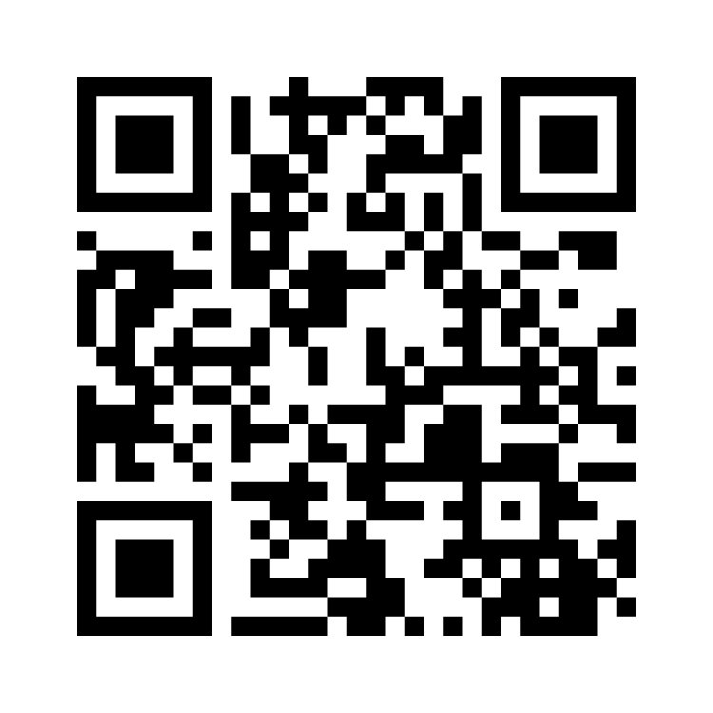
Mentimeter Survey
www.menti.com
4212 4152

Slide 9
Contact Information
Any and all questions and comments:
  Zachary Feldman: Manager, Data Science and Analytics, zfeldman@drcog.org
Additional DRCOG contact:
  Geoffrey Chiapella: Senior Planner, Data Science and Analytics, gchiapella@drcog.org
  Andy Taylor: Manager, Regional Planning and Analytics, ataylor@drcog.org

Slide 10
QUESTIONS?
THANK YOU!
Zachary Feldman, PhD
Manager, Data Science and Analytics
zfeldman@drcog.org
303-480-5637

