Slide 1
Mile High Compact 2.0?
Aligning local and regional initiatives for greater collective impact
Brad Calvert, Denver Regional Council of Governments
Regional Planning and Development Director

Slide 2
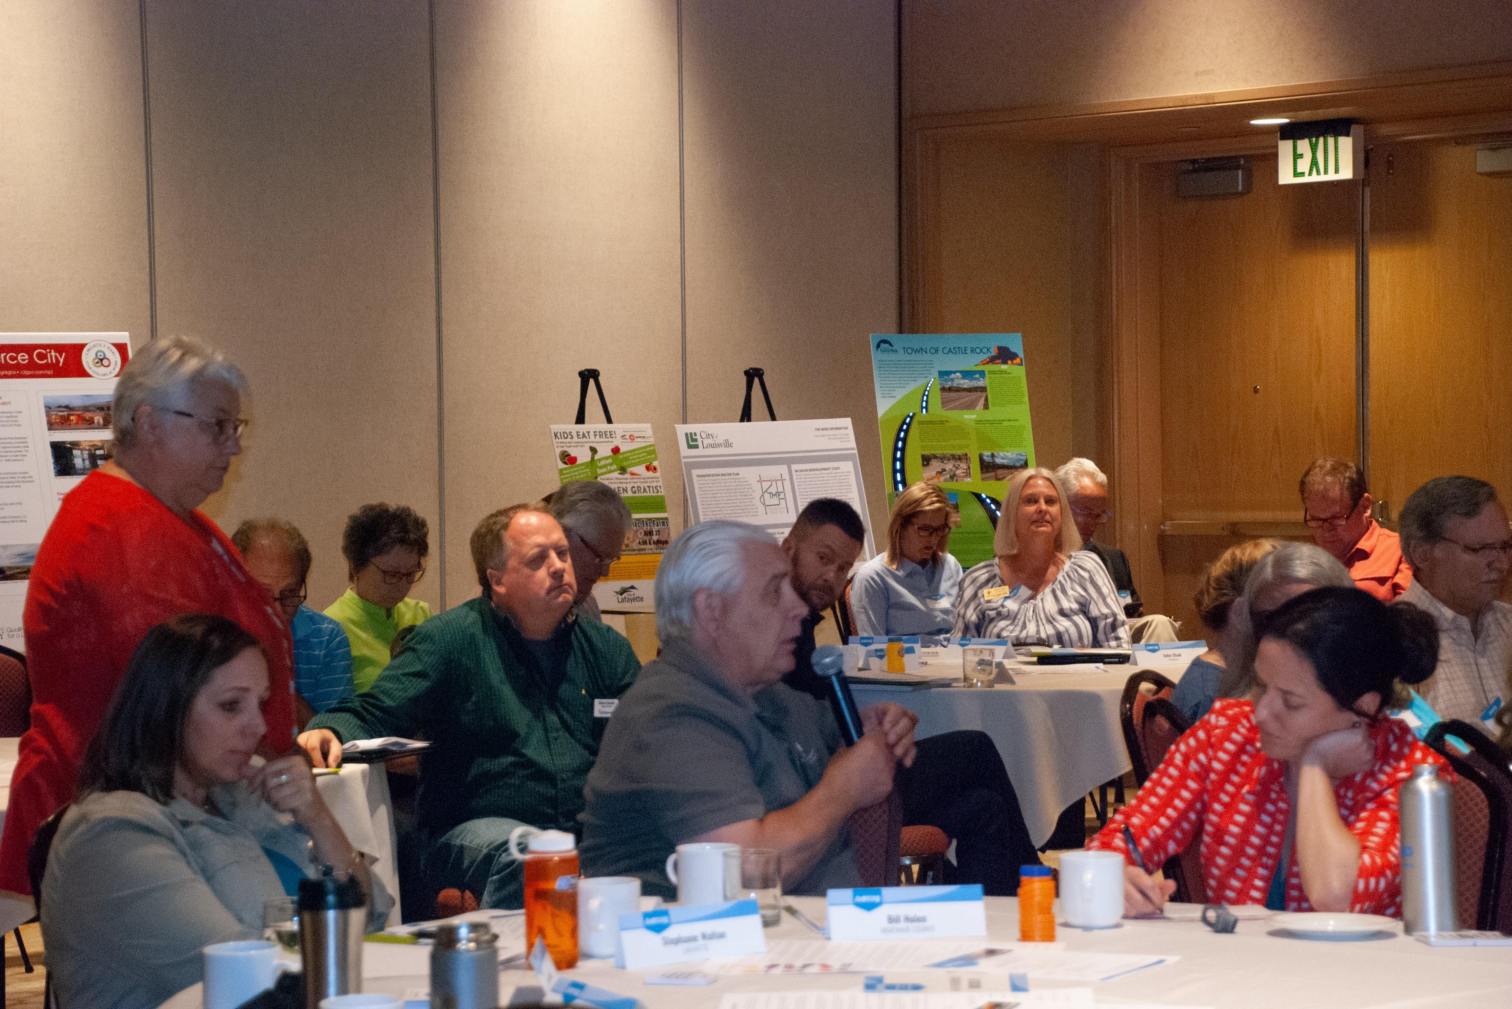
DRCOG BOARD DISCUSSIONS
DRCOG Board of Directors – Aug. 21:
Metro Vision 2020 – A retrospective analysis of goals and accomplishments
DRCOG Board Workshop – Aug. 24:
Metro Vision Implementation: Mile High Compact 2.0?
Opportunities for local governments to contribute the success of Metro Vision, resulting in collective impact in the region…
2

Slide 3
METRO VISION 2020
Metro Vision 2020 was adopted in 1997/2000. The plan outlined strategies and implementation steps to preserve quality of life while also positioning the region to benefit from growth.

Slide 4
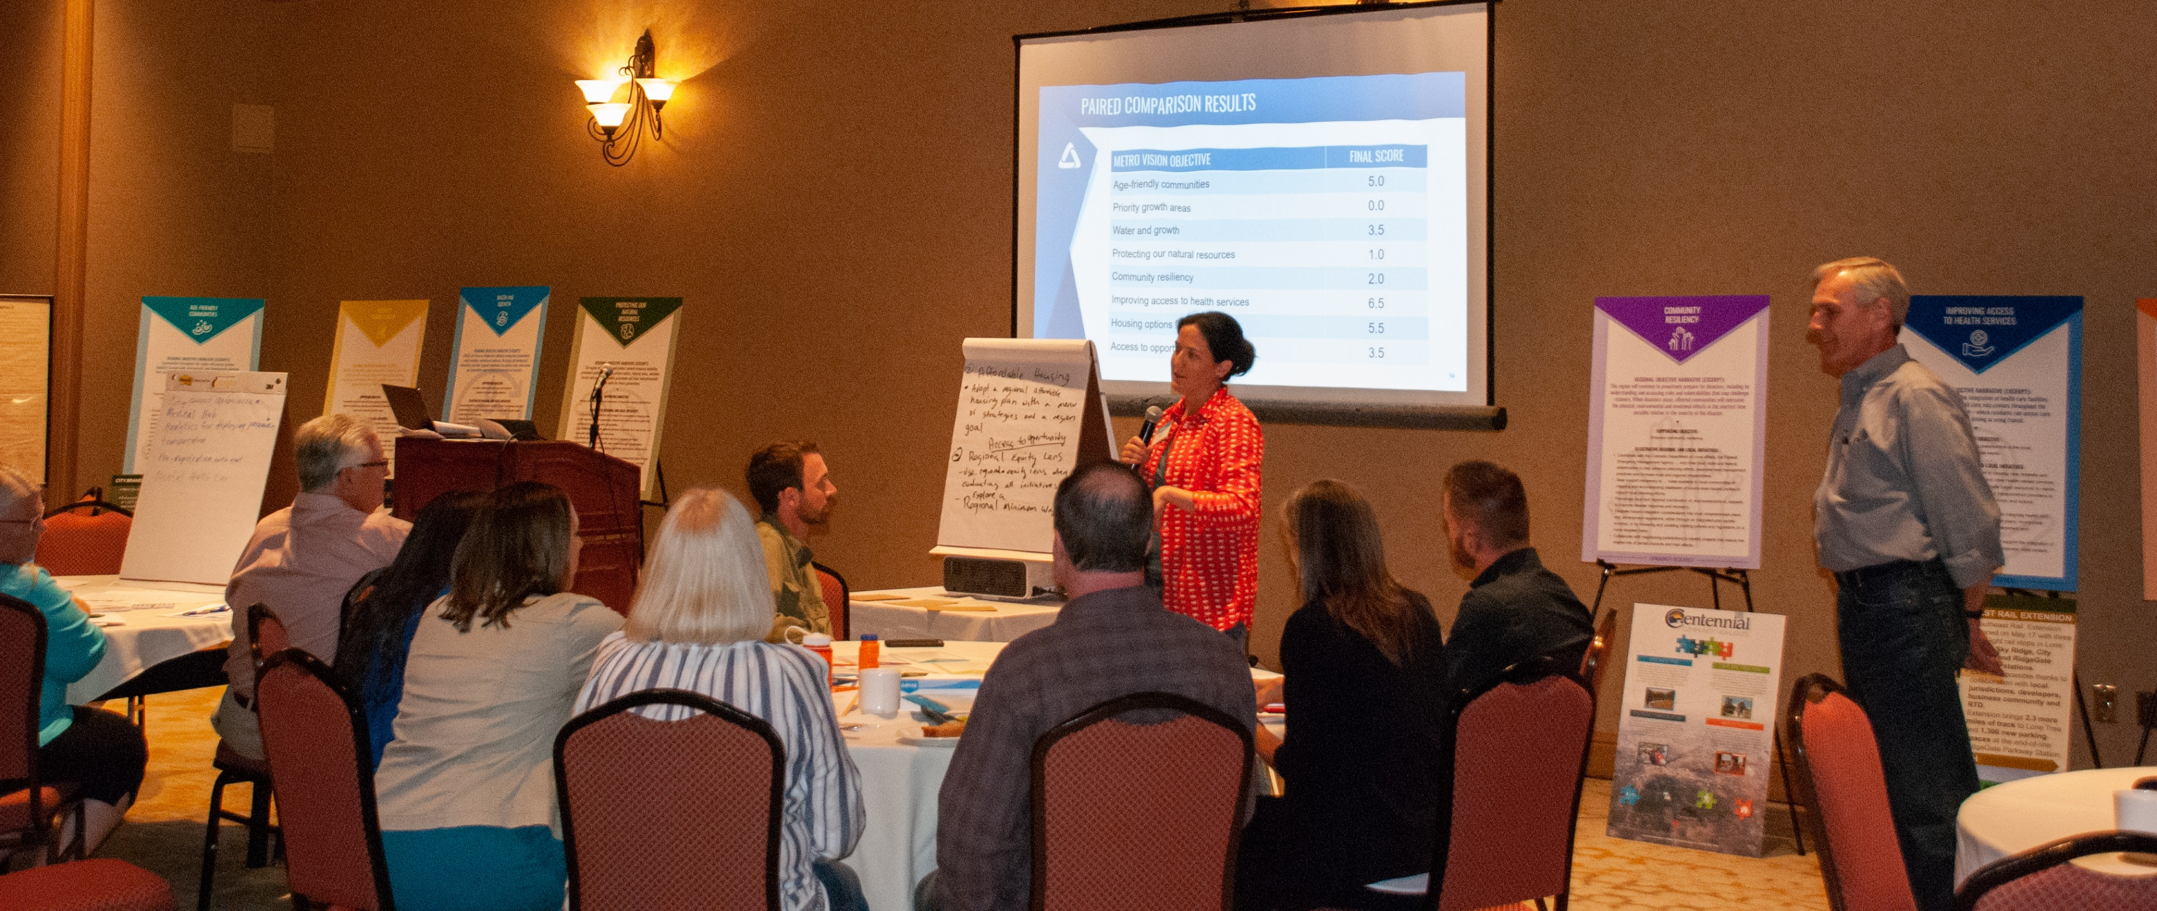
Board Workshop
?
Mile High
Compact 2.0
Board workshop discussion:
Evaluate opportunities to align local and regional initiatives with the current Metro Vision.
Did not seek to answer this question: “Do we need a new Mile High Compact?”
Contribute to initial thinking on proposals for future Board discussion and consideration.

Slide 5
Mile High Compact - Background

Slide 6
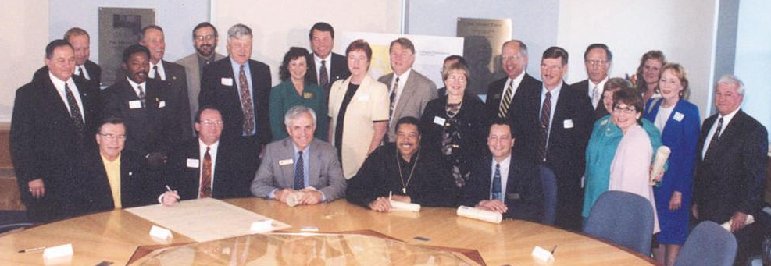
MILE HIGH COMPACT: HIGH-LEVEL OVERVIEW
Set the bar for local comprehensive plans:
included specific topics, such as urban growth boundary/area
intergovernmental agreement
Note: DRCOG is not a party to the agreement.
2000

Slide 7
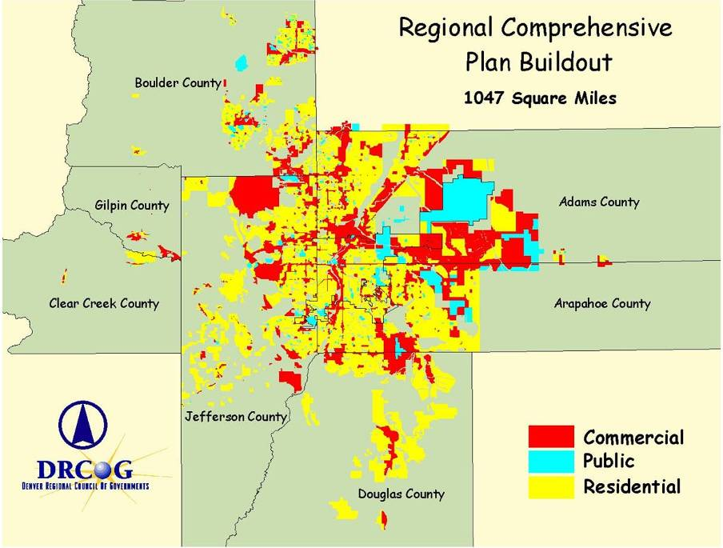
Cumulative growth aspirations: 1990s
WHAT WAS THE BOARD’S MOTIVATION?
desire for tool(s) to create a focused, shared outcome
cumulative aspirations, late 1990s
1,000-plus square mile buildout

Slide 8
MILE HIGH COMPACT: SHORTHAND VERSION
WHEREAS, the Cities and Counties recognize that growth and development decisions can impact neighboring jurisdictions and the region; and
WHEREAS, Metro Vision 2020, collaboratively created by DRCOG members, business, environmental and neighborhood leaders; provides a regional framework for local decisions on growth and development within the Denver Regional Council of Governments’ (DRCOG) region; and

Slide 9
MILE HIGH COMPACT: SHORTHAND VERSION (cont.)
NOW, THEREFORE, in consideration of the mutual promises and covenants contained herein, the undersigned Cities and Counties (hereinafter referred to as we) agree as follows:
1. Metro Vision 2020. We acknowledge that Metro Vision 2020 is the comprehensive guide for the development of the region. Moreover, we agree that Metro Vision 2020 is a dynamic document that reflects changes in the region.
2. Comprehensive/Master Plan. We acknowledge that comprehensive/master plans are critical tools in translating the community’s vision into more specific goals, policies and programs to manage their long-range growth consistent with the communities’ and the region’s vision. We agree to develop and approve comprehensive/master plans for each of our respective communities and to update these plans on a regular basis, as determined by each jurisdiction.

Slide 10
MILE HIGH COMPACT: SHORTHAND VERSION (cont.)
Urban Growth Areas or Urban Growth Boundaries. We agree to adopt Urban Growth Areas or Urban Growth Boundaries, as established by Metro Vision 2020, within our comprehensive/master plans, or in the case of counties by resolution of the Board of Commissioners, and to allow urban development only within those areas. We will encourage and support the efficient development within our Urban Growth Areas or Urban Growth Boundaries consistent with the goals of Metro Vision 2020. Modifications to Urban Growth Areas or Urban Growth Boundaries will be addressed through Metro Vision 2020’s flexibility process. We agree to address nonurban growth outside of the Urban Growth Area or Urban Growth Boundary through subregional planning, intergovernmental agreements, comprehensive/master plans or revised Metro Vision policies.

Slide 11
MILE HIGH COMPACT PARTICIPANTS

Slide 12
Mile High Compact 2.0?

Slide 13
DRCOG’S STRATEGIC APPROACH
strategic altitude
What is our purpose?
30,000 feet
mission
What is our view of the future?
vision
What performance lenses should we use to evaluate results?
strategic
perspectives
What are our main focus areas? What outcomes do we want for our communities and residents?
overarching themes and outcomes
25,000
What continuous improvement
activities will support our outcomes?
objectives
How do we create and improve value for our communities/residents?
strategy map
How will we know if we are
achieving the results we want?
performance measures and targets
15,000
What projects will best contribute to our outcomes?
strategic initiatives
ground level

Slide 14
METRO VISION IS THE STARTING POINT…
Metro Vision – Overarching Themes
An Efficient and Predictable Development Pattern
A Connected Multimodal Region
A Safe and Resilient Natural and Built Environment
Healthy, Inclusive and Livable Communities
A Vibrant Regional Economy

Slide 15
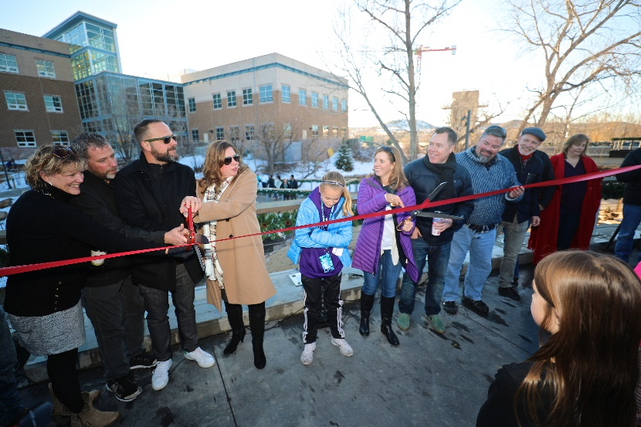
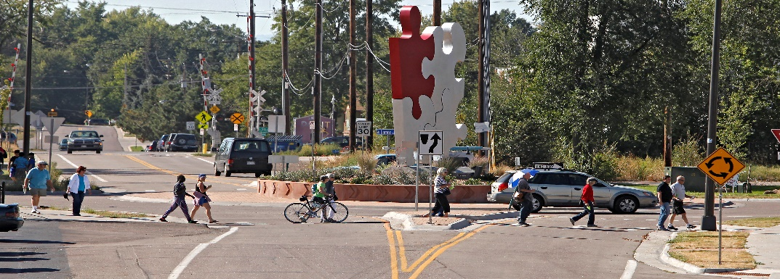
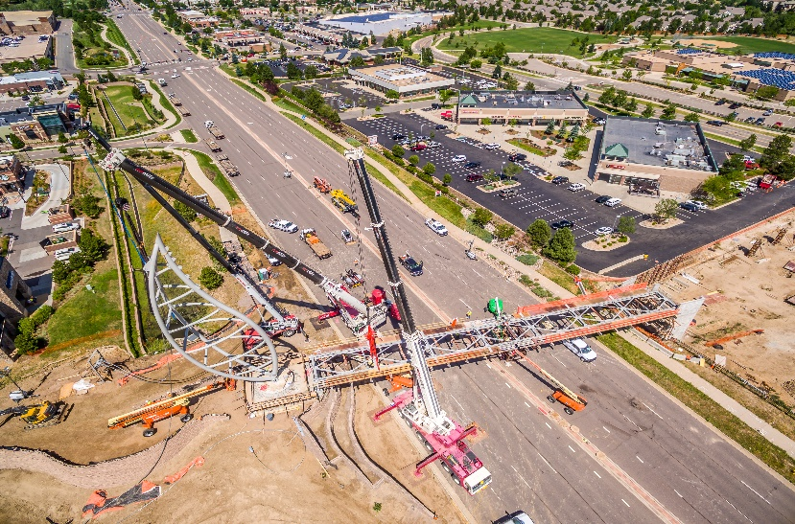
WE ARE ALL WORKING TOWARD COLLECTIVE IMPACT…
The plan anticipates that individual communities will contribute to Metro Vision outcomes and objectives…

Slide 16
BOARD WORKSHOP – INITIAL EVALUATION
All options were pulled directly from the unanimously adopted Metro Vision plan.
Options live at the objective level – where continuous improvements are needed to achieve a desired outcome.
Initial screen by DRCOG staff:
identified objectives where there is room for both local commitments and regional support
identified objectives not directly associated with an active, fully operational DRCOG program

Slide 17
BOARD WORKSHOP – INITIAL EVALUATION (cont.)
Thinking of the entire region, which options would provide the greatest opportunity for local governments in the region to contribute the success of Metro Vision, resulting in collective impact in the region?

Slide 18
PAIRED COMPARISON - METRO VISION OBJECTIVES

Slide 19
PAIRED COMPARISON - METRO VISION OBJECTIVES (cont.)

Slide 20
PAIRED COMPARISON RESULTS
METRO VISION OBJECTIVE | FINAL RANKING
Improving access to health services | 1
Housing options for all | 2
Age-friendly communities | 3
Access to opportunity* | 4
Water and growth | 4
Community resiliency | 6
Protecting our natural resources | 7
Priority growth areas | 8

Slide 21
Board Workshop – initial feedback
analytics for deploying paramedics
behavioral health tax
‘collaborative’ health care – info sharing, etc. (holistic)
transportation access – connecting residents to health care services
change zoning to encourage connected services in priority areas

Slide 22
Board Workshop – initial feedback (cont.)
lobby state and fed for low-income tax credits
affordable housing goals/targets in local comp plans
adopt region affordable housing plan with menu of strategies and a regional goal

Slide 23
Board Workshop – initial feedback (cont.)
access to opportunity needs to be applied to all objectives – “equity lens”
equity should be considered when evaluation ALL initiatives
explore a regional minimum wage

Slide 24
NEXT STEPS (STAFF)
Support future Board discussion: further prioritization & direction on initiative-level components for potential agreement(s)
Peer region interviews:
Bay Area: CASA Compact
Washington, D.C.: Regional Housing Targets
Salt Lake City: SB 34
Regional resource interviews:
DU Grand Challenges Collective Impact Cohorts
Boulder County Regional Affordable Housing Plan

Slide 25
NEXT STEPS (BOARD): GUIDANCE NEEDED
Background
Existing agreement was the nation’s first voluntary city- and county-led effort to guide growth
In 2000, only 4 months transpired between initial drafting and signing ceremony
This was possible, in part, because the effort was co-spearheaded by Metro Mayors Caucus
Questions
Does the Board prefer to be the primary designer, drafter, evaluator and marketer of a new agreement?
…or, is there interest in involving other organizations?

Slide 26
QUESTIONS?
THANK YOU!
Brad Calvert
Regional Planning and Development Director
bcalvert@drcog.org
303-480-6839

