Slide 1
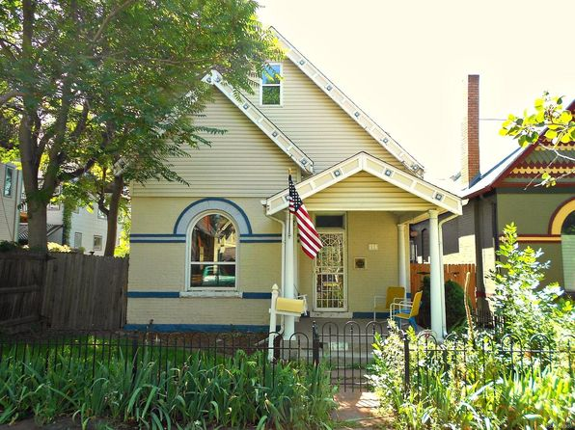
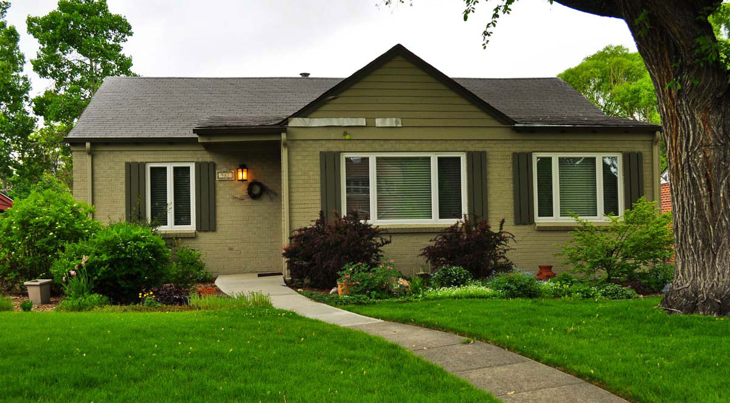
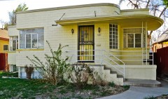
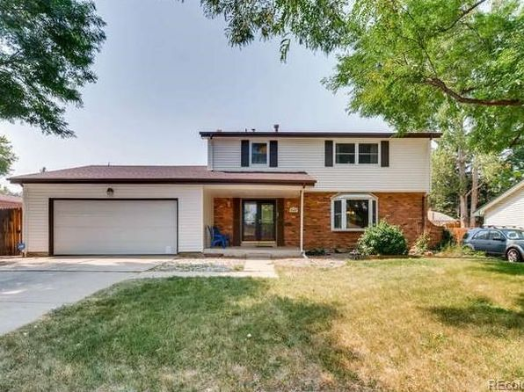
Doubling Up and Dealing With It:
Responding to Shared Housing Arrangements
Travis Parker, Planning Director, City of Lakewood
Tina Axelrad, Zoning Administrator, City of Denver
Don Elliott, FAICP, Clarion Associates, Denver
DRCOG Idea Exchange – February 28, 2018

Slide 2
Background

Slide 3

What’s the Problem?
There is a serious mismatch between current housing supply and demand
  Large supply of larger lot single-family detached housing exceeds long-term demand
  The demand for smaller housing units
    Driven by personal preferences
    Driven by smaller households
    Driven by affordability

Slide 4
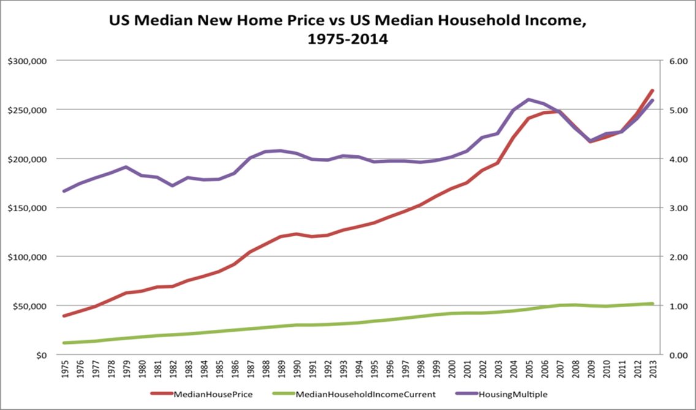
The
Housing Price /
Wage
Gap

Slide 5
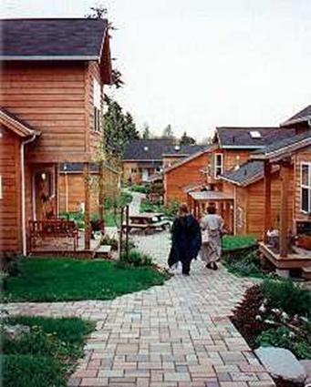
What’s the Problem?
Over time, the market align supply and demand
We’ll build more small lot and attached units and fewer large lot homes
But we only replace 2% of the housing stock each year
Many larger homes in secondary locations locations will face decreasing demand and lower prices

Slide 6
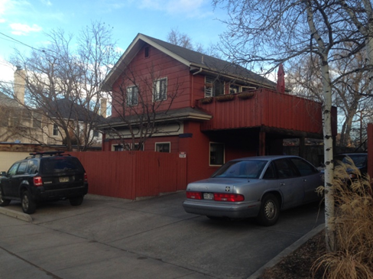
What’s the Problem?
Declining demand for larger homes on larger lots will result in “Doubling up” of more than one household occupying the home
We’re already seeing this
Three generation homes
Demand for ADUs and AirBnb
Creation of illegal apartments

Slide 7

What’s the Problem?
Legal Occupancy of Housing Units is governed by
Building & Occupancy codes (rarely violated)
Zoning ordinances limits on the number of unrelated people)
Restrictive covenants
But enforcement could make many people illegal occupants – and when too many people are in violation the rules don’t get enforced

Slide 8
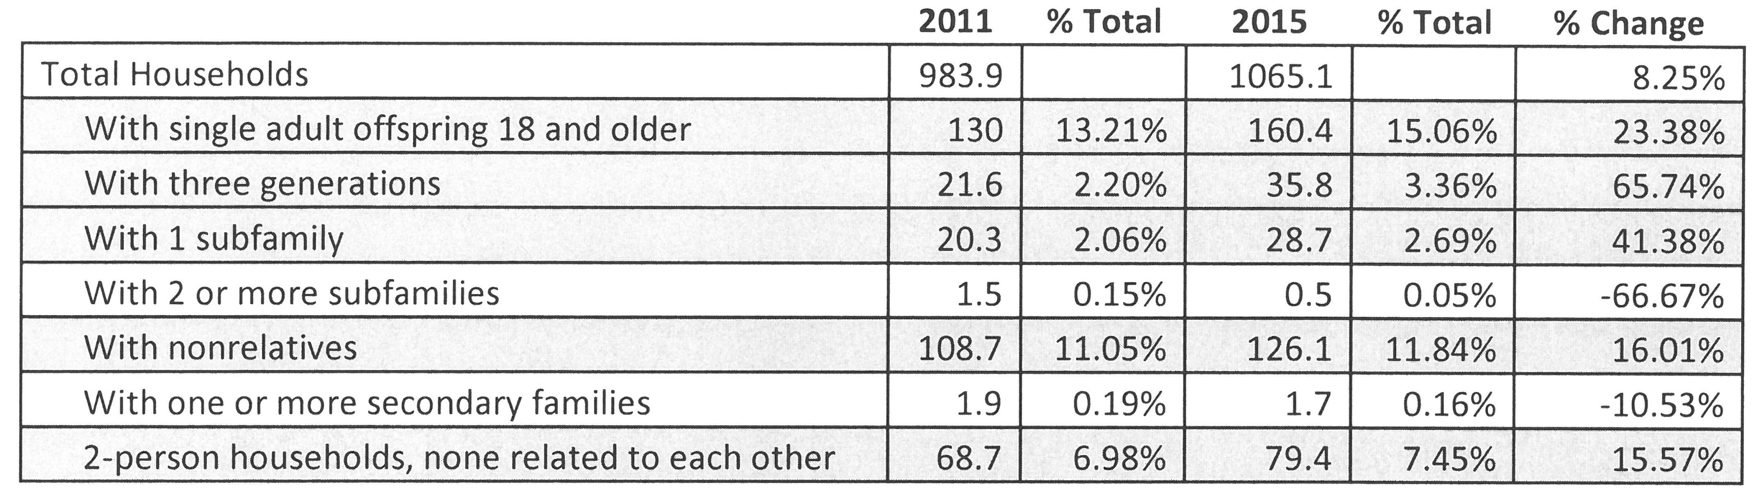
What’s the Problem?
American Household Survey Data for Denver-Aurora-Lakewood MSA
Subfamily – e.g. young couple moves in with bride’s parents
Secondary Family – 2 or more people related to each other, but not related to the householder

Slide 9

What’s the Problem?
We’ve seen this before
  1960s “white flight” results in many urban single-family homes divided into apartments (legally or illegally)
  All large cities struggle with the creation of illegal additional second or third units
  Many newer ADU ordinances on the east and west coasts have been aimed at providing a “path to legality” for large numbers of illegal apartments

Slide 10

What’s the Problem?
The ability to “hold the line” against multi-family occupancy varies
  Governmental enforcement is expensive and politically unpopular
  Private enforcement depends on an active HOA or Condo Association
  Many HOAs are weak – particularly in poorer neighborhoods

Slide 11
The Lakewood Story
Presented by:
Travis Parker, City of Lakewood Planning Director
DRCOG Idea Exchange – February 28, 2018

Slide 12
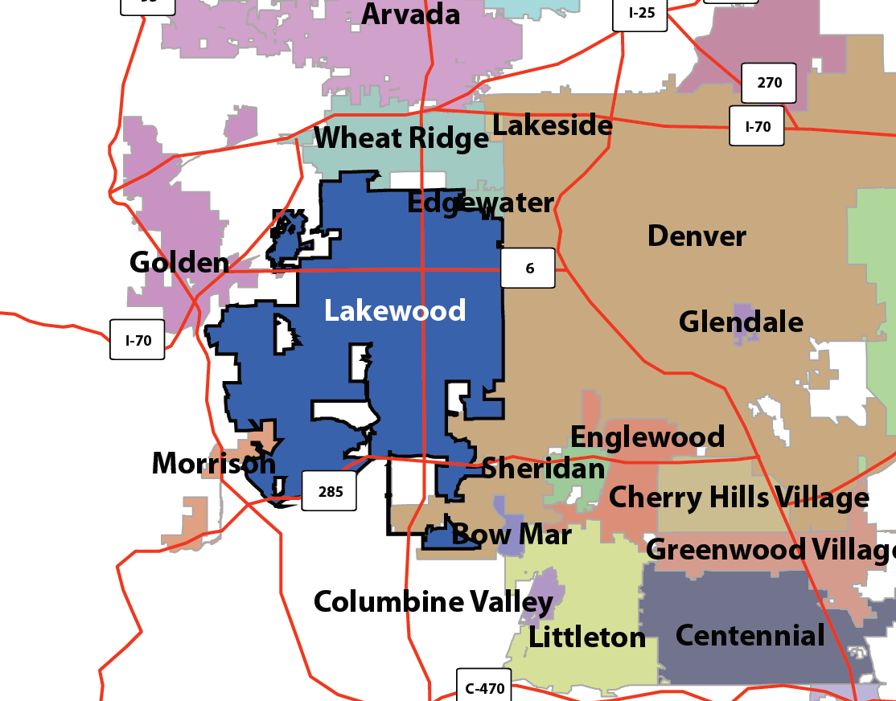
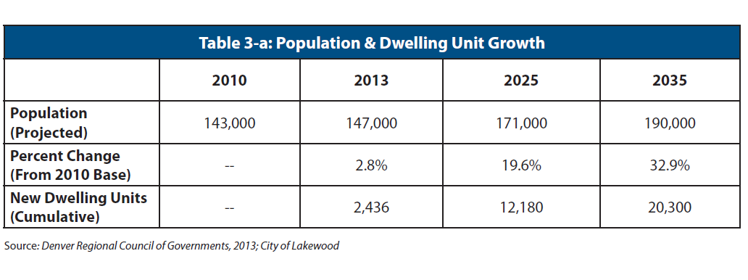
Population Projections

Slide 13
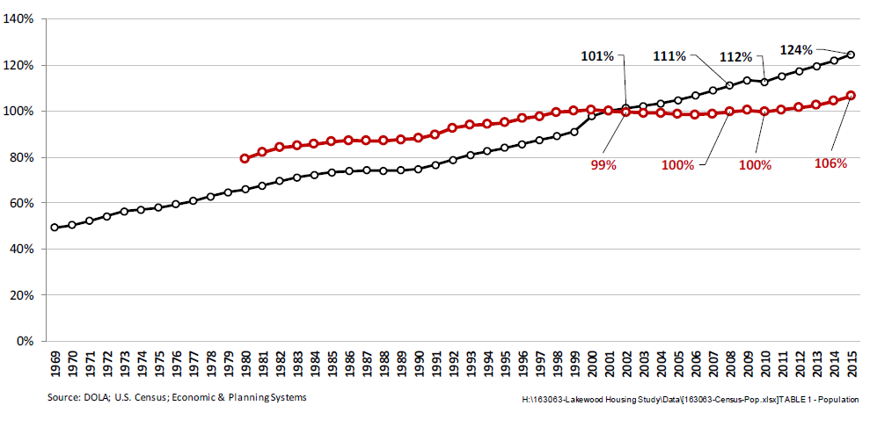
Lakewood is under-performing in new housing
1 new home for every 3 new jobs

Slide 14
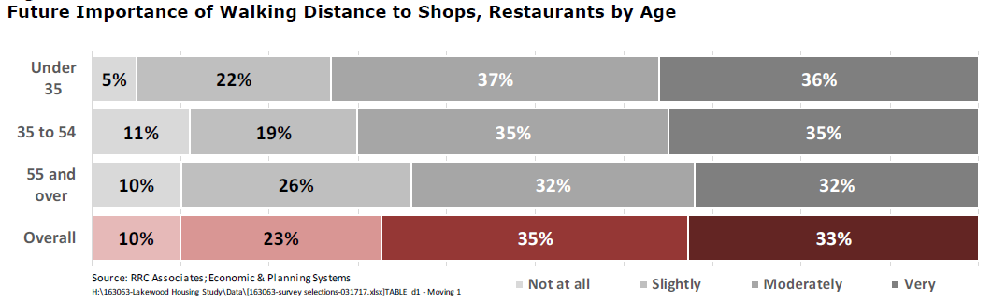
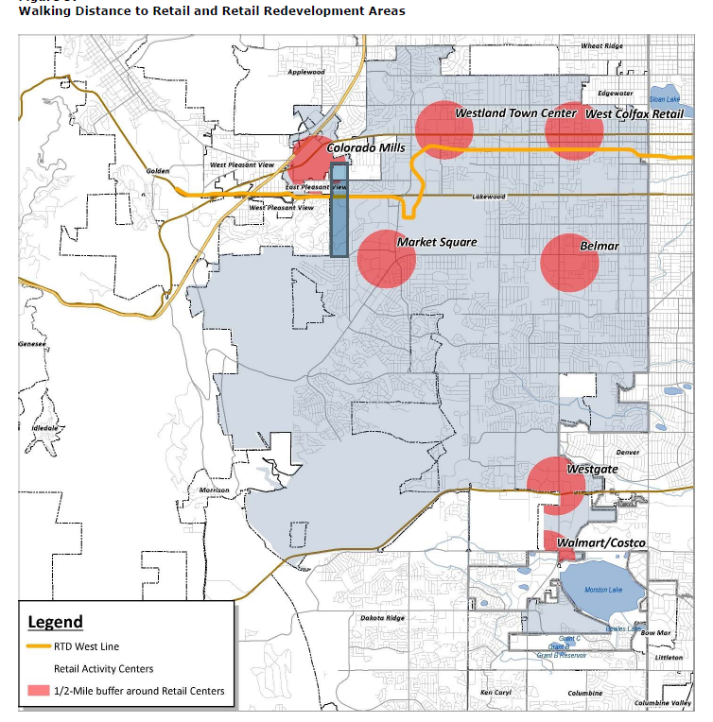
Mismatch between supply and demand:
Retail

Slide 15
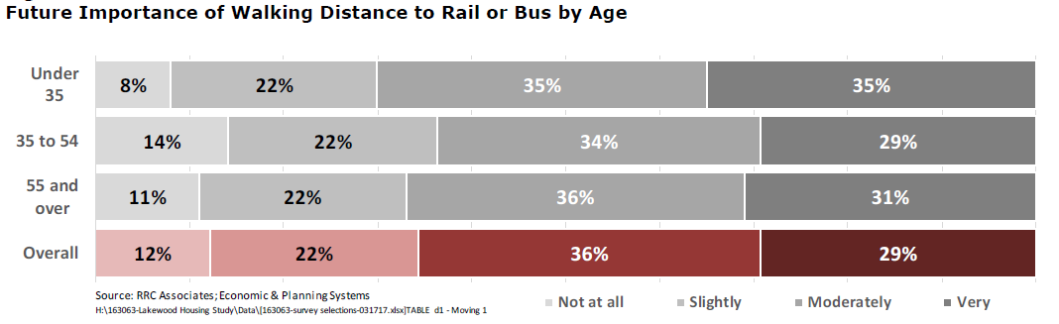
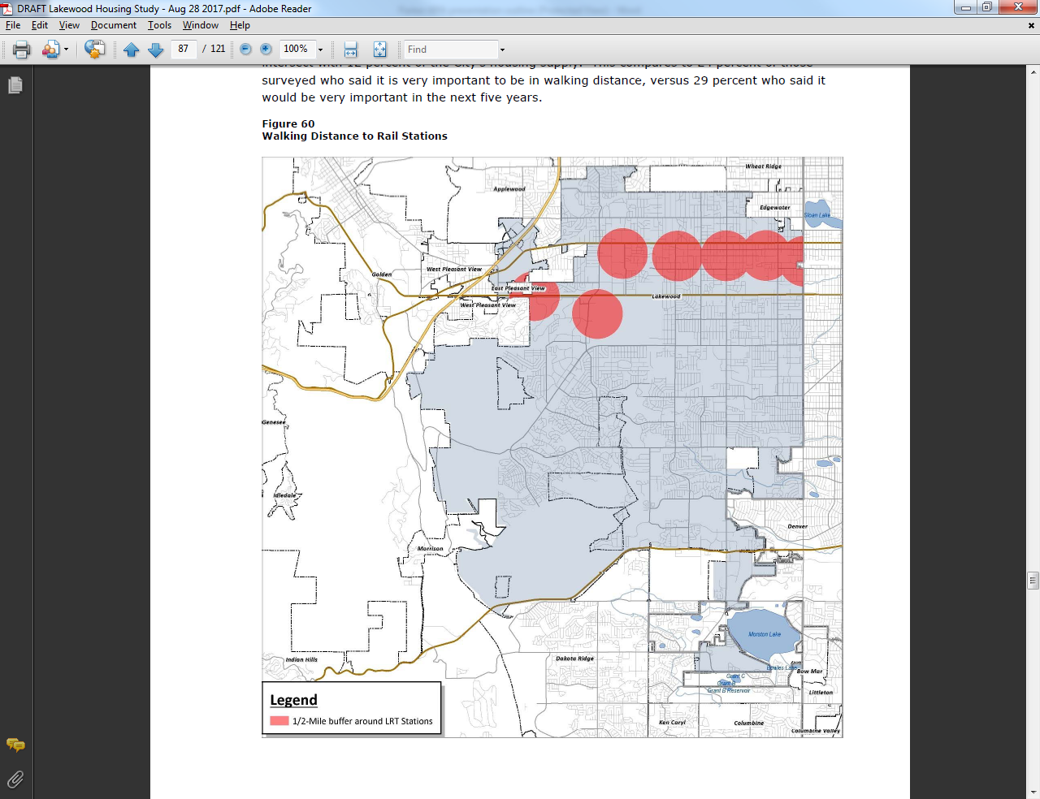
Mismatch between supply and demand:
Transit

Slide 16
Rising Costs
Median Home Price 2012: $212,000
2017: $368,000
Median Rent 2012: $985
2017: $1312
Apt Vacancy Rate Metro: 5.7%
    Lakewood 4.4%

Slide 17
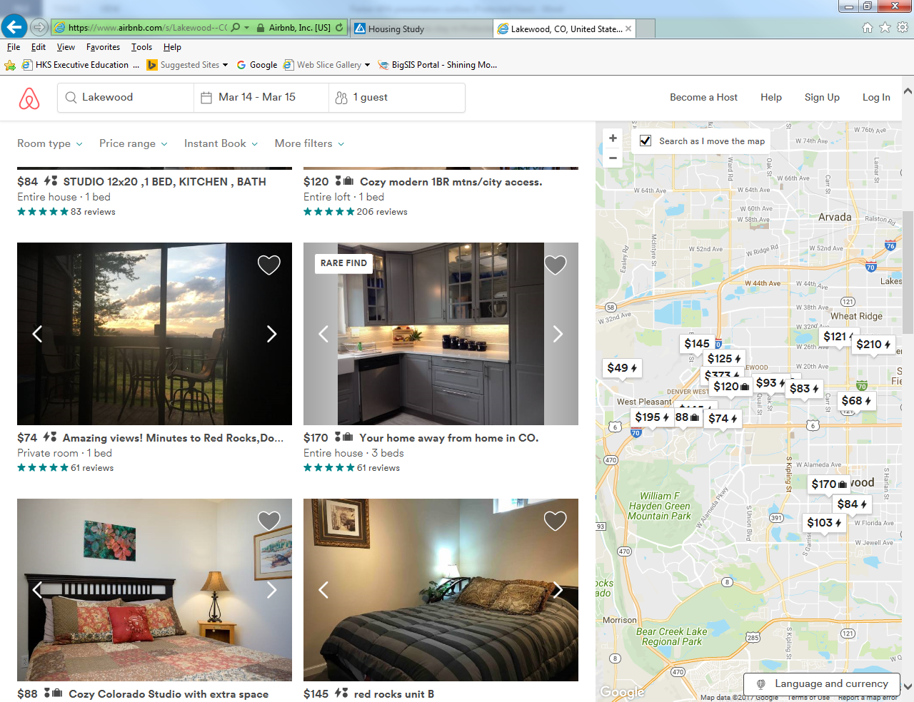
Nearly 1% of housing units in Lakewood are available for short term rental

Slide 18
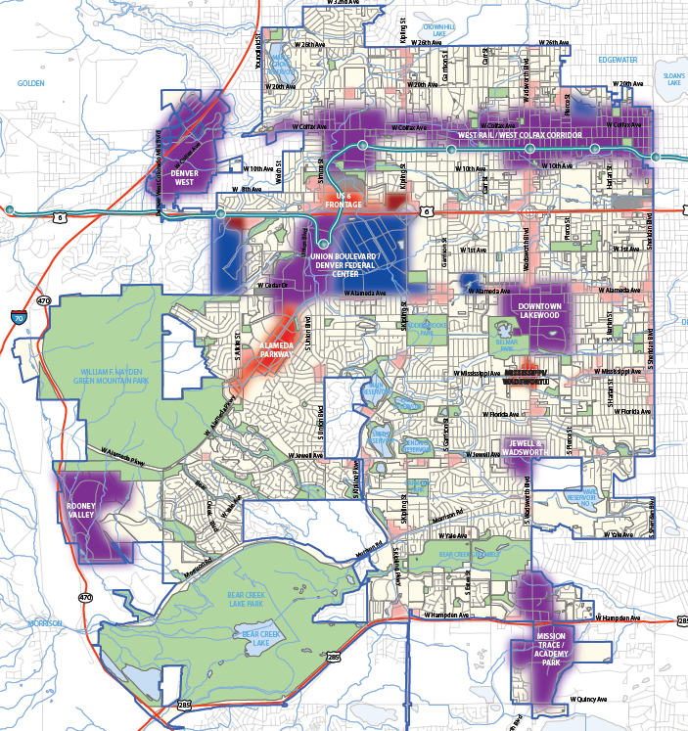
Attempted Solutions:
Mixed Use Zoning
Mixed Use Zoning

Slide 19
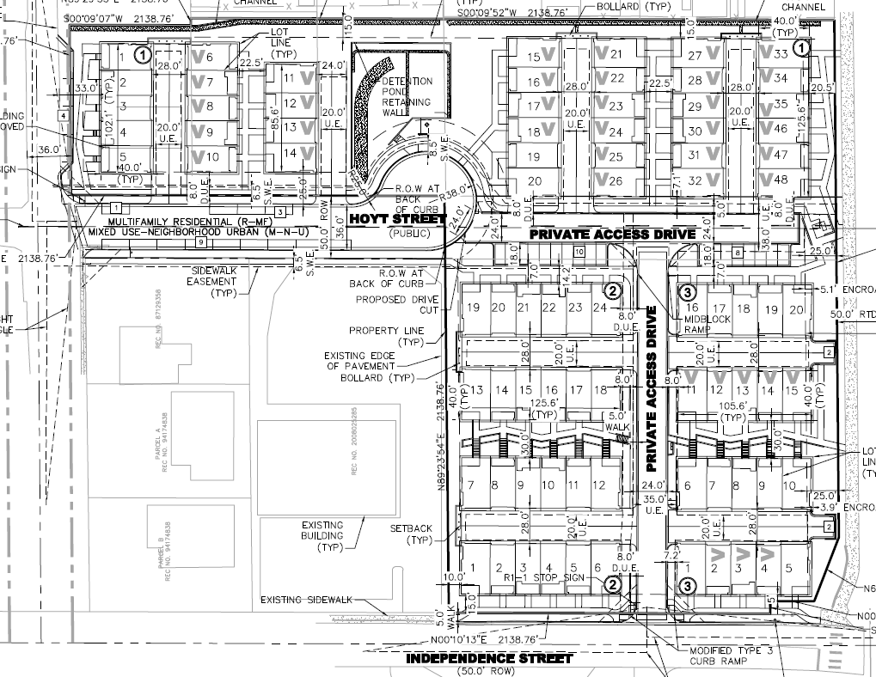
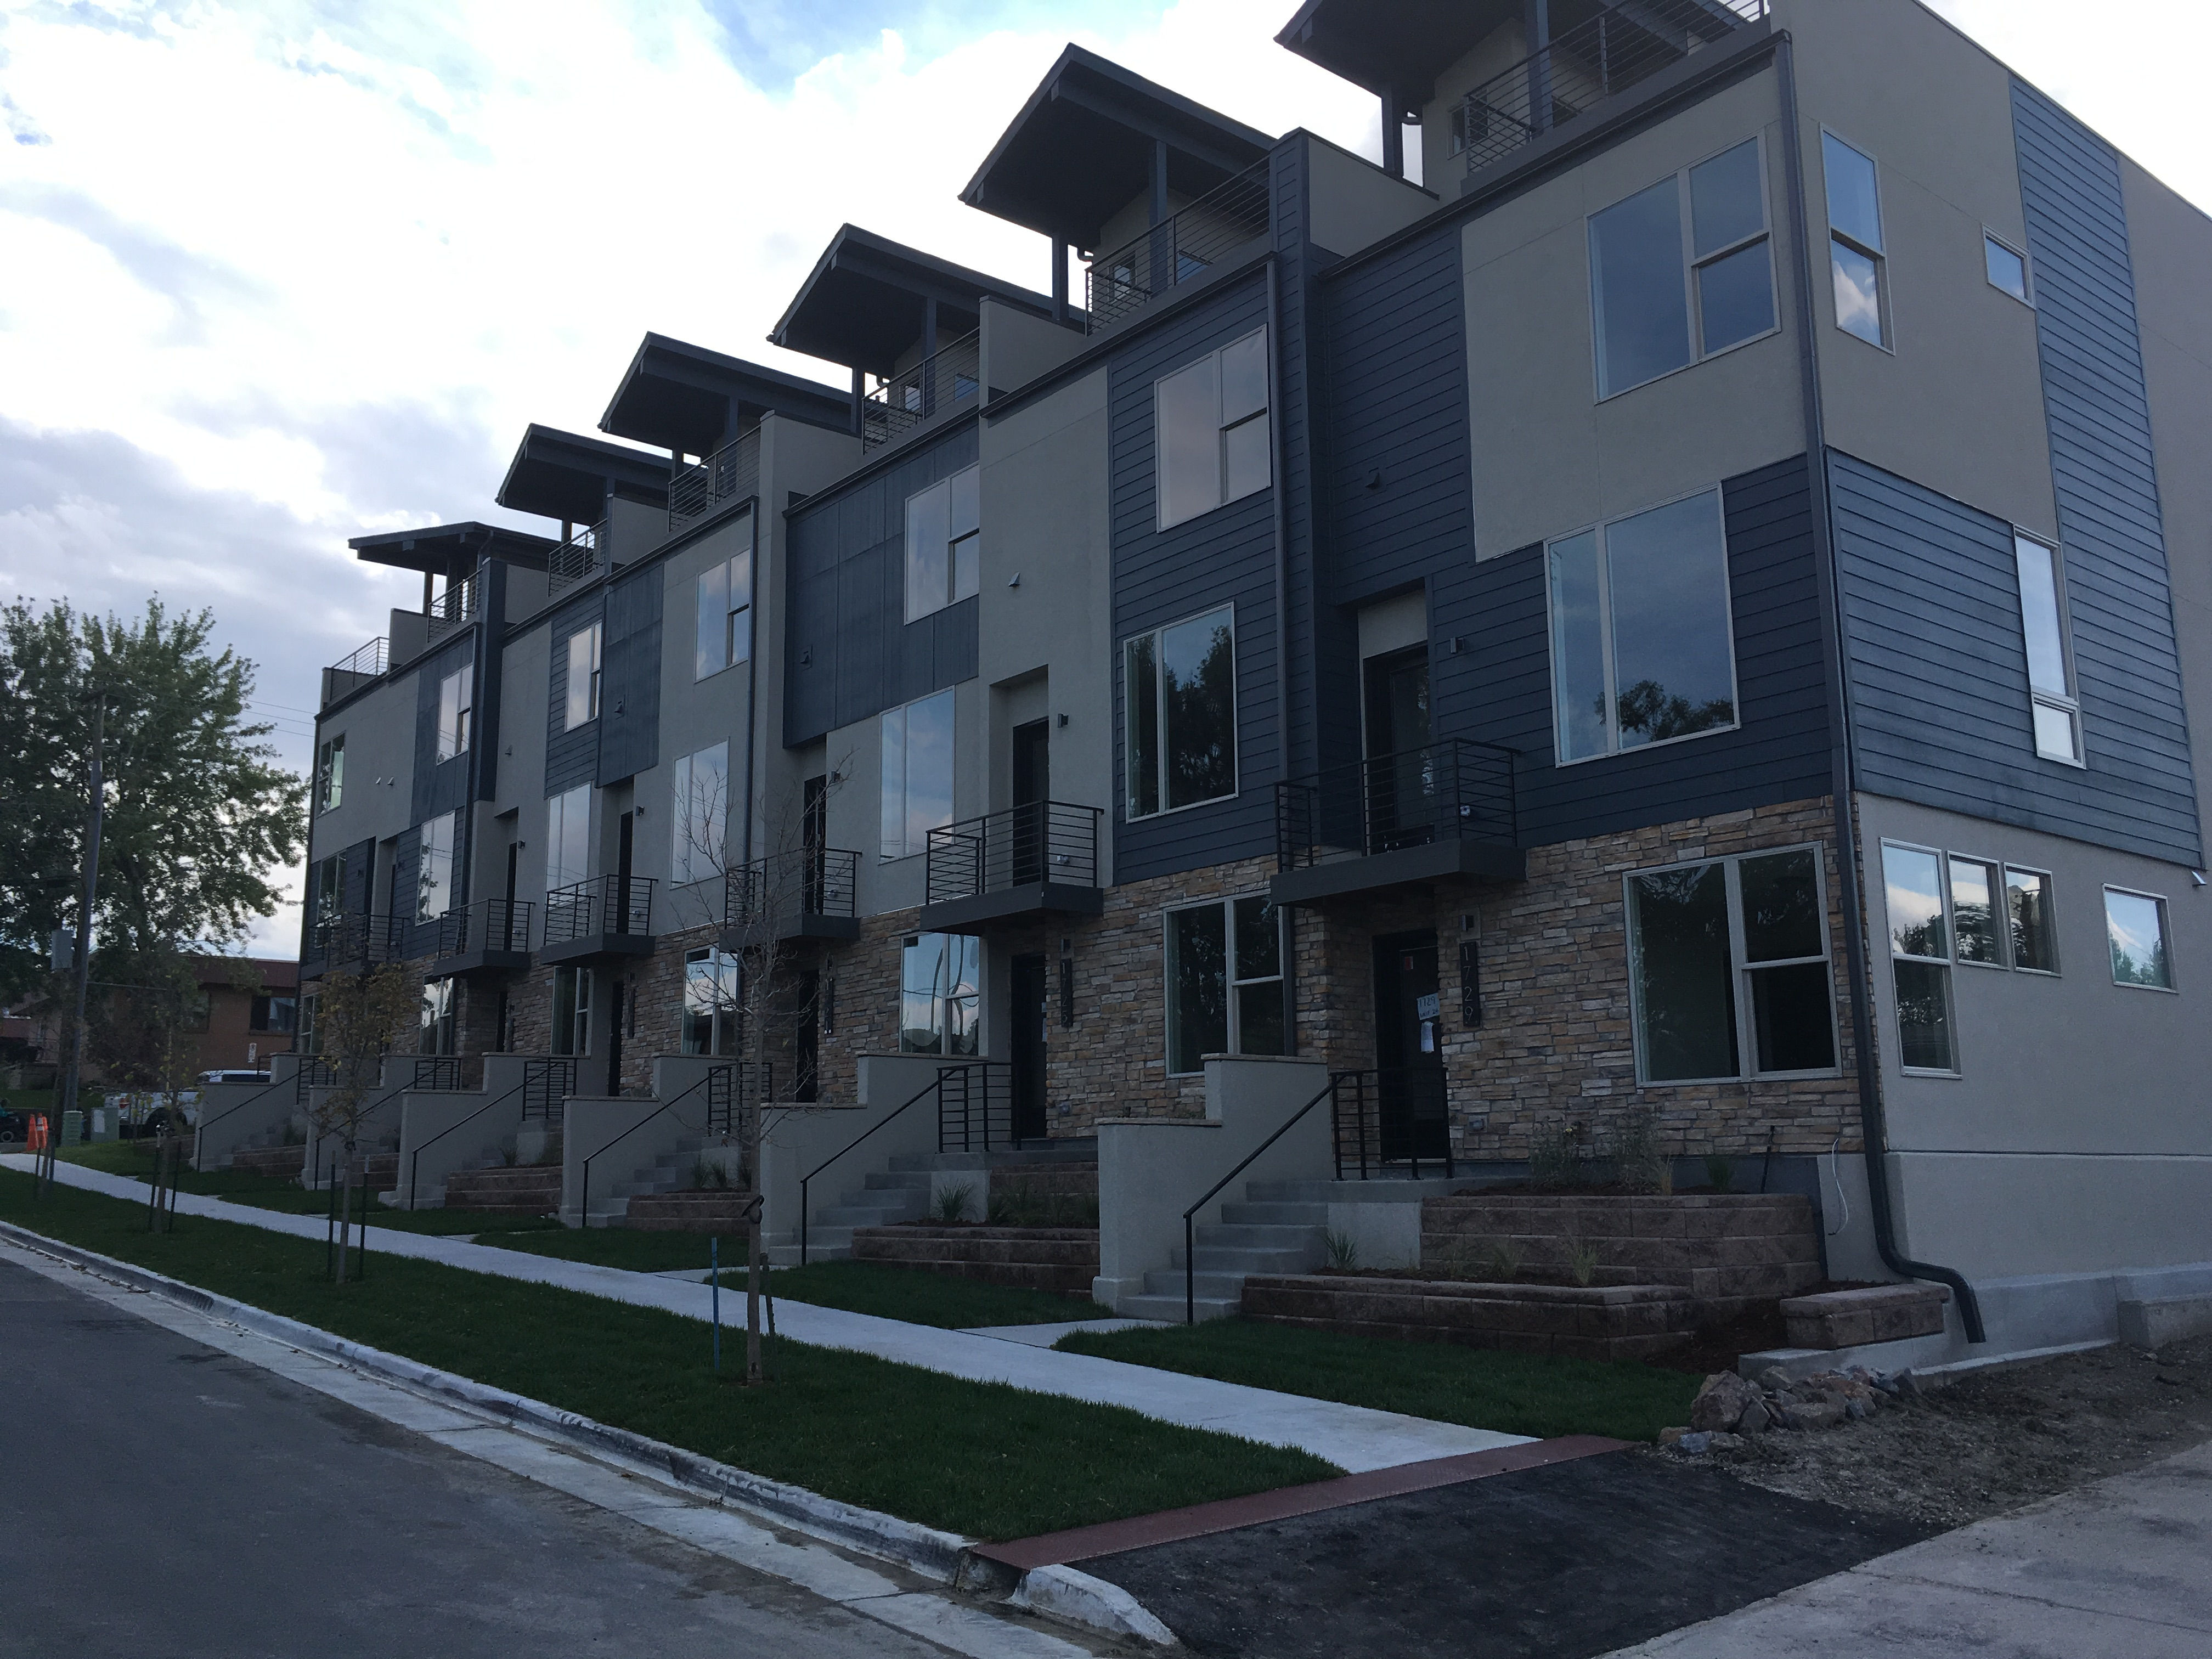
Attempted Solutions:
Townhouse Infill

Slide 20
Attempted Solutions:
ADUs and
Tiny Homes
Permitted ADUs in 2012 subject to conditions:
  Max 700 sf
  Only lots >9000 sf
  Owner must live onsite
  Minimal exterior changes allowed
  Require a permit
Mixed-use zoning allows tiny homes

Slide 21
Attempted Solutions:
Construction Defects
No condo development since 2006
2014 ordinance attempts to balance homeowner protections with limitation on frivolous suits
  Requires 50% vote of all owners prior to legal action
  Prevents retroactive HOA changes to remove arbitration requirements
Currently 2 condo buildings and 2 large townhome projects in planning process

Slide 22
Attempted Solutions:
Short term rentals
City currently considering ordinance to permit and regulate short term rentals
Proposal copies Denver’s ordinance
Would require licensing and enforcement

Slide 23
Continuing Challenges:
Anti-Growth sentiment
Ballot initiative proposes limiting residential growth to 1% per year
Strong citizen pushback on recent developments
Council candidates dividing on growth issues

Slide 24
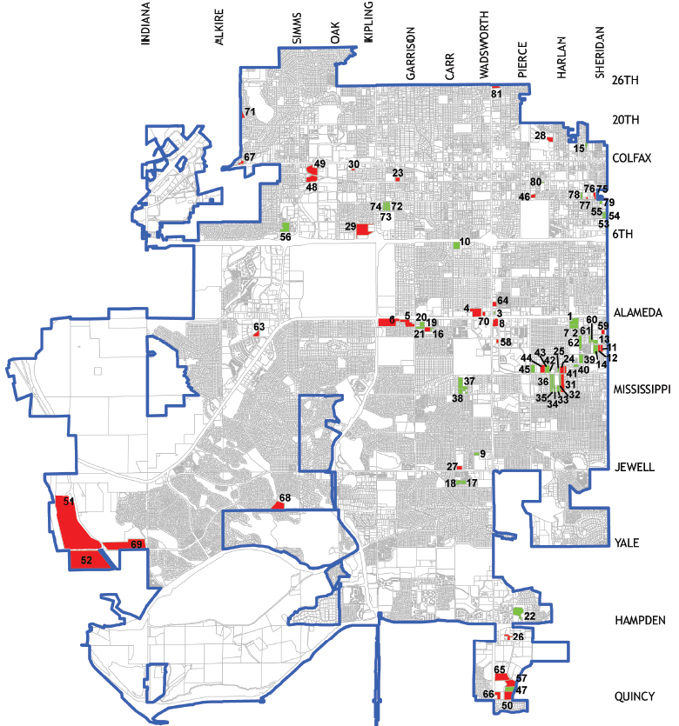
Continuing Challenges:
Diminishing development opportunities

Slide 25
Continuing Challenges:
Expensive Alternatives
Water tap fees
Other fees
Conditions for approval
Permitting and Building Codes
Lessons Learned:
  Minimize barriers to entry
  Make fees proportional
  Solve for water

Slide 26
The Denver Story
Presented by:
Tina Axelrad, City of Denver Zoning Administrator

Slide 27
Evidence of a Growing Housing Challenge

Slide 28
Population by the Numbers
2016: 693,060
2040: 812,052
The population growth at the time of 2002 Blueprint Denver was for an additional 109,000 residents by 2020
Since the 2002 Blueprint Denver, the city has grown by 121,000 residents
Denver is expected to grow by another 119,000 persons by 2040
65 percent of this population growth (78,000 people) occurred between 2010 to 2015
Denver was the 5th fastest-growing large city (population > 250,000) in the nation in 2014 and the third fastest city in the U.S. from 2005-2014

Slide 29
Housing by the Numbers
Median Home Price = $386,700
Median Rent Price = $2,000
Despite significant population growth, Denver was denser in 1950 than it is today
Nearly evenly split between owner-occupied and renter-occupied units
  But renter households accounted for over 75 percent of the new households since 2000
Denver has permitted at least 5,500 housing units annually since 2012, which is 30 percent more annually than from 2000 to 2008
The average rental rate in Denver has grown by the highest percentage than comparable cities
Despite the large increase in housing costs in Denver, the median home value in Denver is 40 percent lower than it is in Seattle
Notes:
The new housing development since 2010 has shifted to become primarily multifamily as opposed to single family (4:1 ratio). This trend is likely to continue as Denver’s larger areas for single family home development (Green Valley Ranch, Lowry, and Stapleton) are mostly built out;
Denver’s comparable U.S. cities include Austin, Minneapolis, Portland, Salt Lake City, and Seattle.

Slide 30
Denver neighborhoods with greatest proportion of new development

Slide 31
Jobs by the Numbers
Total employment in Denver was approximately 473,000 in 2014
Denver accounts for 35 percent of employment in the MSA, however has only captured 23 percent employment growth since 2002
More recently from 2012 to 2015, Denver captured a greater share of metro area employment growth - 44 percent of new jobs in that period

Slide 32
Household Income & Housing Expenditures by the Numbers
Median household income by neighborhood ranges from $11, 036 (Sun Valley) to $134,276 (Belcaro) with an average of nearly $58,000 per household
The combined cost of housing and transportation (H + T) across all Denver neighborhoods is as low as 38 percent (Capitol Hill) and as high as 53 percent (Hilltop)
  Several neighborhoods with low average household incomes have relatively high H+T costs (e.g., Globeville has a median household income of just over $25,000 and a combined H+T cost of 42 percent of household income)

Slide 33
Pressures Mounting

Slide 34
What are we Seeing?
Pressure on Single-Family Homes is Mounting…
illegal 2nd dwelling units
illegal use of garages for living space
illegal short-term rentals
  Less since legalized STR in 2016
illegal “group living”
  2 unrelated persons allowed ”by right” per household in single unit dwelling (+ 1 more with home occupation zoning permit for roomer/boarder)
illegal DIY housing – artists, others stressed for housing
requests for zoning exceptions and variances

Slide 35
Attempted & Future Solutions

Slide 36
Attempted Solutions – Short-Term Rentals www.Denvergov.org/STR
Short-Term Rentals – legalized in 2016
  Business license = primary tool = on-line
  Zoning accessory use defined, but zoning permit not required
  STR must occur in person’s primary residence
  Total # licenses count as of Jan 2018 = 2,065 (unique STR properties = 3,866)
  Compliance rate of 64%
  Total Lodger’s Tax revenue collected from STR operators for 2017 : $2,916,831
  Total Notice of Violations issued: 2,024 (advertising without a license)
    232 complaints on 109 licensed premises
  Denver Licensee Survey – 246 responses as of 1/10/18:
    How often do you rent your home?
      35% - One reservation a week
      25% - Several reservations every week
    If you did not conduct short-term rentals (rentals for less than 30 consecutive days), what would you do?
      56% - Nothing
      37% - Rent long term

Slide 37
Attempted Solutions - ADUs
Accessory Dwelling Units – allowed since 2003, expanded in 2010
  In SF zone districts, limits on total GFA, owner occupancy of either primary of ADU dwelling, minimum floor area per resident
  In all other zones, must be accessory to a primary single-unit dwelling use only
  No separate water/sewer tap allowed for ADU
  No parking required for ADU
  Zoning and building permits required for use/occupancy

Slide 38
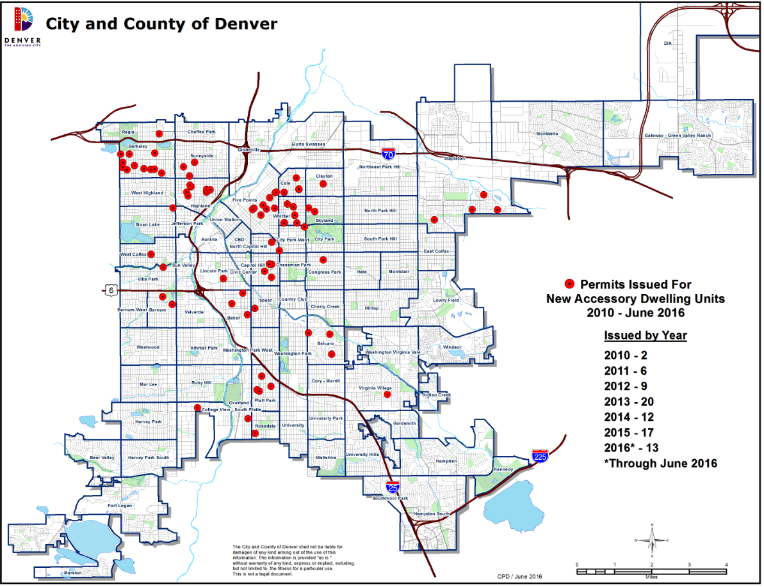
Building Permits Issued for ADUs
2010 - 2016 : 105 permits
2016: 44

Slide 39
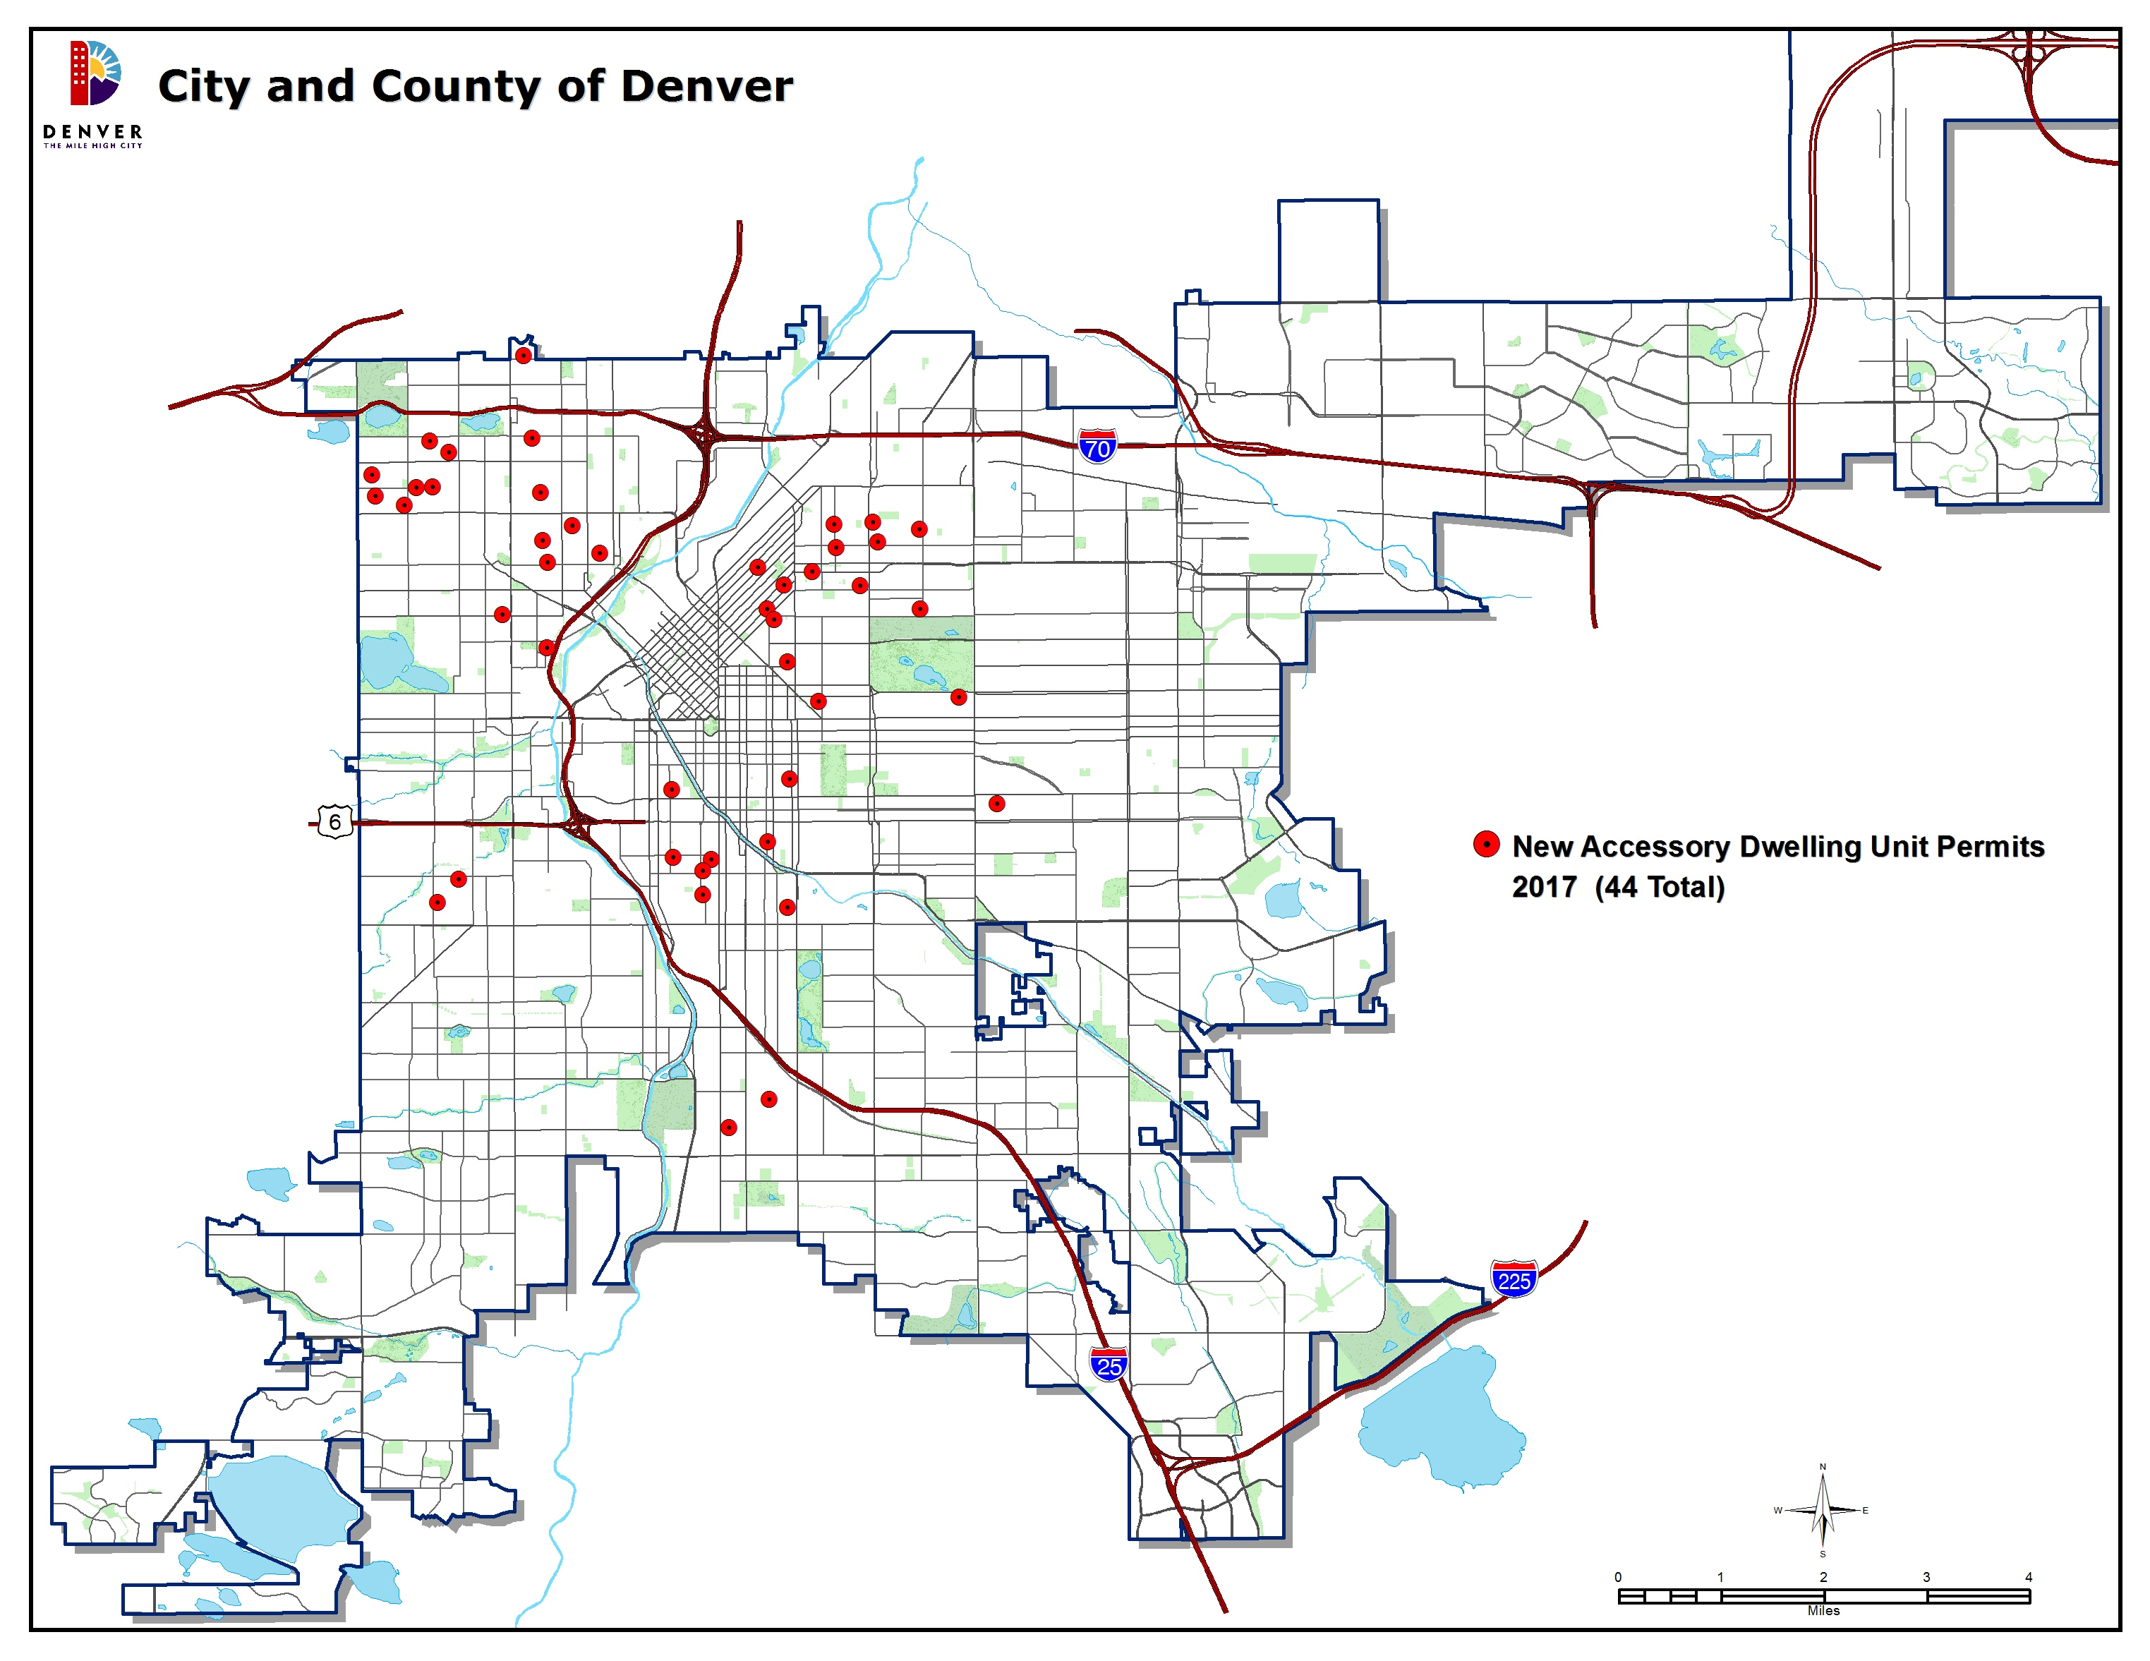
Building Permits Issued for ADUs
2017 – 44 permits

Slide 40
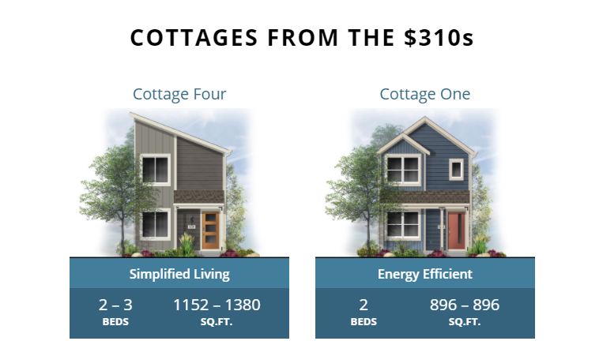
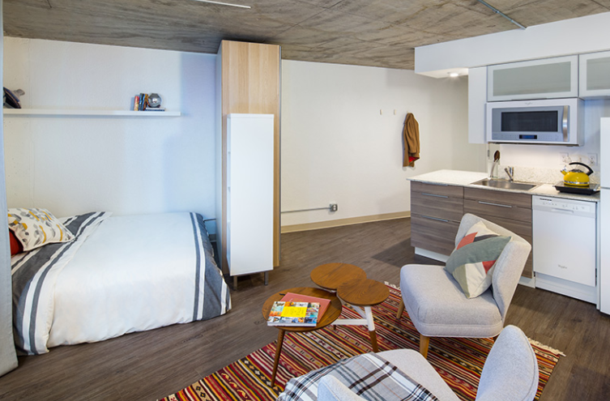
Attempted Solutions
New Housing Types/Options:
  Boulder Creek “wee-Cottage” Stapleton project
  Micro units – small rental units with more common/shared amenities
  Group houses allowed per RLUIPA
  Group houses for older adults (55+ years ~ allowed by-right)
Denver Safe Occupancy Program
  Conditional / Temporary COs and compliance plans for persons seeking building permits ‘after the fact’

Slide 41

Future Solutions?
The Future?
  Revisit “group living” category of land uses, including more flexibility for transitional housing and groups NOT protected by federal fair housing act
  Revisit definition of “household” and number of unrelated persons who may create a household
  Explore allowing ADUs more widespread – in city’s single-unit zones and all other zones – part of citywide land use plan update

Slide 42
What to Do?
Presented by:
Don Elliott, Director, Clarion Associates
DRCOG Idea Exchange – February 28, 2018

Slide 43

How to Respond?
Allow conversion of some part of the single-family housing stock to allow additional dwelling units (larger than ADUs)?
Change the definition of “family” to allow more unrelated people to occupy a single-family dwelling unit?
Speed up efforts to allow smaller dwelling units on smaller lots (but remember the 2% rule)?

Slide 44
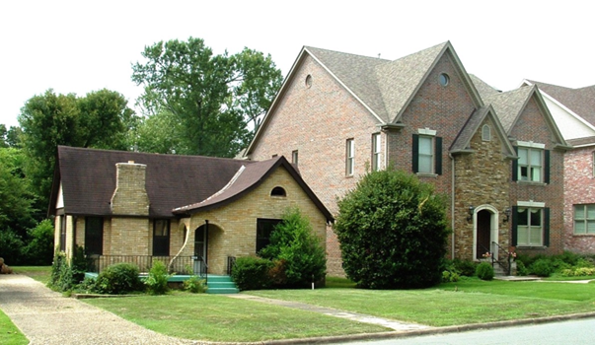
How to Respond?
Allow Conversion of Dwelling Units?
Building codes for multi-family are tougher and more expensive to meet
The same may be true of:
  Energy codes
  Seismic codes
  Zoning codes
  Landscape codes and manuals

Slide 45
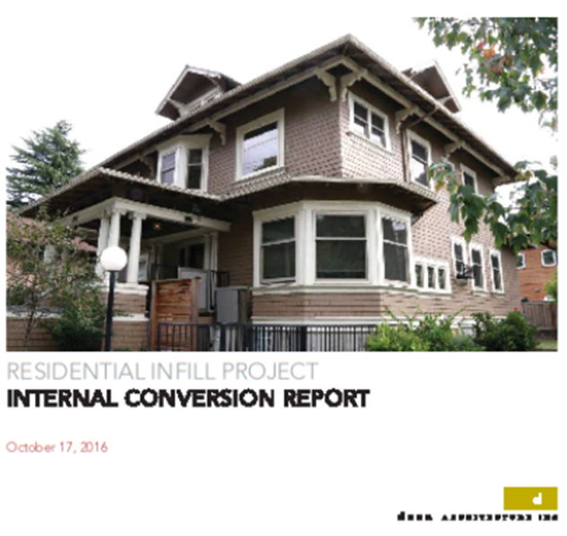
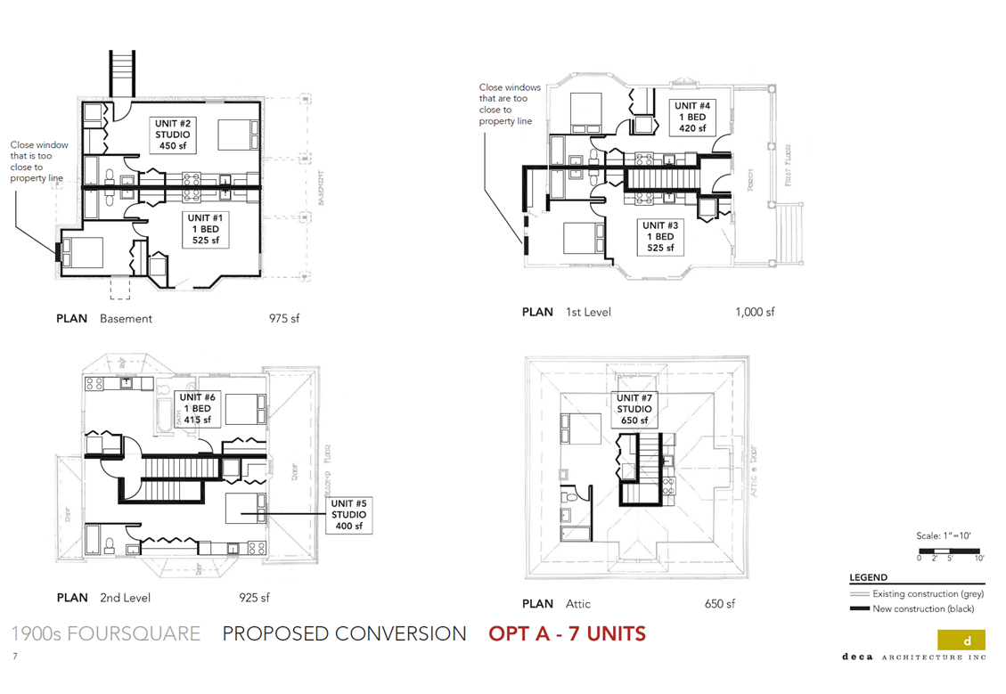
The
Portland, Oregon Study

Slide 46
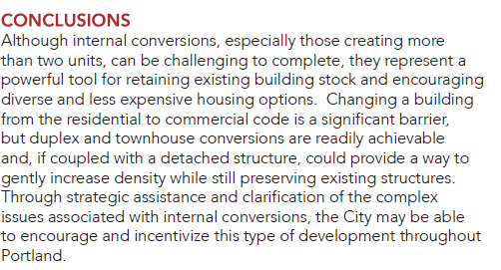
The
Portland, Oregon Study

Slide 47
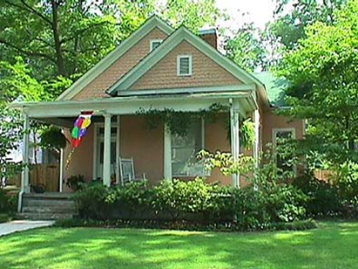
How to Respond?
Single-Family to Duplex or Townhomes Could Make a Big Difference
About 70% of land use in medium sized cities is residential
In most medium sized cities, about 2/3 of that 70% is single-family structures
Rules on conversion of single-family homes could affect almost 50% of the housing stock
  Lots of room to narrow and tailor the rules to local conditions

Slide 48

How to Respond?
Allow Higher Occupancy of Dwelling Units?
Pressure will also exist for higher occupancy without changing the structure
The normal definition of “family” or “household” is:
  Any number of persons related by blood or marriage or
  Up to X unrelated persons

Slide 49

How to Respond?
Several problems with this definition
Any number of persons related by blood or marriage
  Declining marriage rates means fewer households will meet this standard
Up to X unrelated persons
  You could increase X
Fails to reflect requirements of the federal Fair Housing Act
  Add “or any group of individuals whose right to live together is protected by state or federal fair housing laws”

Slide 50
How to Respond?
The Right Response(s) Will Vary by Community
Determine whether pressures to “double up” exist in your community
If so, determine what types of adjustments are needed
If “doubling up” is happening
-- Don’t pretend that it isn’t
-- The more violators you have, the harder it is to fix

Slide 51

Questions and Discussion

