Slide 1
Why Housing Matters PRESENTATION TEMPLATE
DRCOG Regional Housing Strategy / Tools for Talking About Housing
NOTE TO USER: DELETE THIS SLIDE FROM YOUR FINAL PRESENTATION
Purpose and Use
Use the following slides to talk about housing issues and priorities in your community from both a local and regional perspective.
The slides are intended for a general audience but can be customized for your specific group. You can cut, paste and delete to use only those slides that meet your needs.
Integrate with engagement activities to understand community perspectives and priorities. Refer to the accompanying ”Let’s Talk Housing" Messaging Playbook for ideas.
Suggested talking points for each slide are also provided in the ”Let’s Talk Housing" Messaging Playbook .
Customize the slides to reflect local community context, strategies, and/or priorities.

Slide 2
Why Housing Matters PRESENTATION TEMPLATE continued
DRCOG Regional Housing Strategy / Tools for Talking About Housing
NOTE TO USER: DELETE THIS SLIDE FROM YOUR FINAL PRESENTATION
Customizing the Template
ADD your jurisdiction's or organization’s name and logo to the title slide along with info about the time/date of your presentation.
DELETE this and the previous slide as well as any other slides that are not pertinent to your audience or your jurisdiction.
MODIFY specific terms, photos, and content to ensure it reflects your jurisdiction/organization’s or audience’s perspectives and priorities. Replace the photos with images of places, people and housing that will resonate with your audience.
  To change photos: right click on the image you want to change and select “Change picture.”
  To adjust image size: right click and choose “Crop.”
ADD slides that provide more information about local strategies and priorities to address the housing challenges specific to your community.

Slide 3

Why Housing Matters
Meeting Name / Date / Time
Update with local seal/logo or remove

Slide 4

Why Housing Matters
  Housing is where we live, raise our families, and grow old
  Housing is one of the biggest investments of our lives (for owners and renters)
  Safe, secure housing is critical to our health and well being
  Housing is essential for our workforce and our community’s economic health
  When housing is close to jobs, schools and services, it helps reduce trips and traffic congestion

Slide 5

Why Does Housing Matter to You?
We want to hear from you!

Slide 6
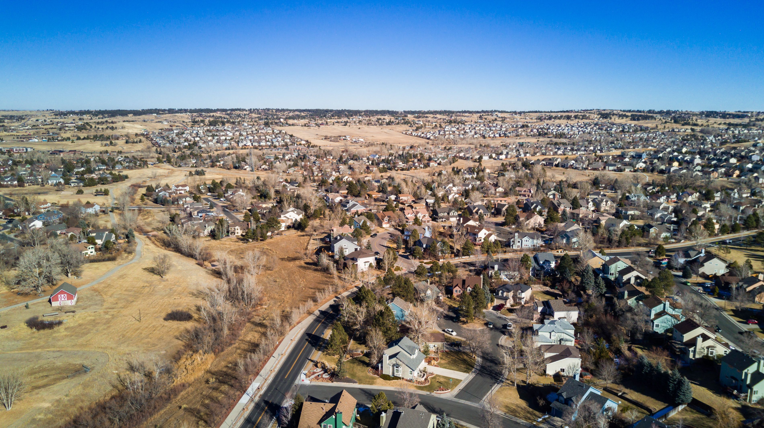
Housing in Our Region

Slide 7
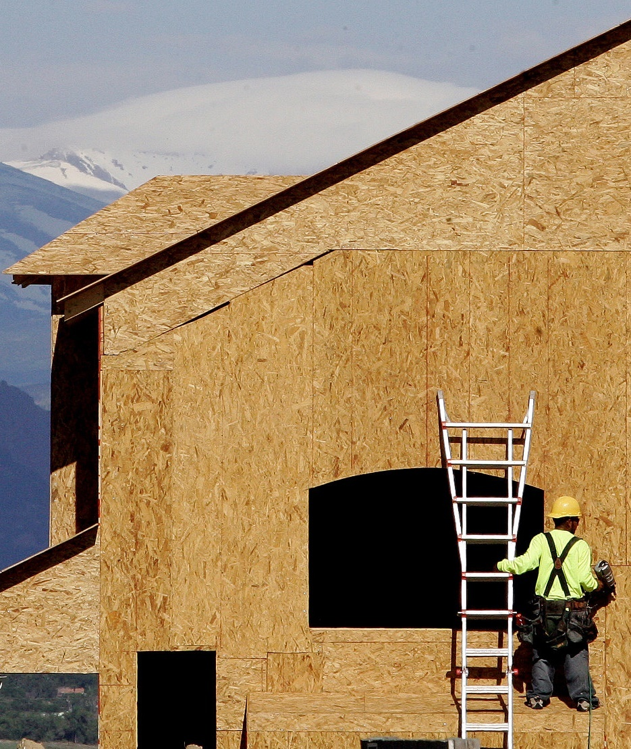
We've been building a lot of new housing, but not enough to meet our growing needs.
Despite periodic building booms, our region has not created enough homes to keep pace with population and job growth.
We are not building enough of the right kinds of homes, in the right locations.
The shortage of housing is contributing to higher home prices and rents and making housing unaffordable for many, especially lower income households.

Slide 8
Our biggest gap is in homes for low-income households.
Notes:
Source: ECOnorthwest analysis; DRCOG synthesis of State Demography Office 2022 Household Forecast and U.S. Census Bureau, American Community Survey 5-year 2013 Public Use Microdata Sample estimates; Metro Denver Homeless Initiative State of Homelessness Report, 2022–2023

Slide 9

Many people are being priced out.
The increase in home costs have outpaced growth in household incomes.
More than half of renters in our region pay over 30 percent of their income on housing.
Many people have to live far away from work or school to find homes they can afford.
Between 2010 and 2020, our region’s median household income increased by 66 percent while the median home price doubled.

Slide 10

Many workers have to pay a large percent of their income on housing
Occupation | Average Annual Income | Income Category | % of Income on Housing (for a $1,600/mo apartment)
Store Clerk | $38,000 | Extremely Low-Income (less than 30% AMI) | 50%
Barista | $40,000 | Very Low-Income (less than 50% AMI) | 48%
Medical Assistant | $53,000 | Low-Income (less than 80% AMI) | 36%
Teacher | $60,000 | Low-Income (less than 80% AMI) | 32%
Firefighter | $68,000 | Low-Income (less than 80% AMI) | 28%

Slide 11




And our housing needs will continue to grow…
Recent analysis shows that our region is short 52,000 homes to meet current needs
Plus we will need 216,000 more homes over the next ten years
By 2050 we will need 511,000 more homes in the Denver region than we have today
Targets | Homes
Long-Term Target: | 511,000 new homes by 2050
Short-Term Target: | 216,000 new homes by 2033

Slide 12

We will need more diverse housing, too.
Our population is getting older, which will change the kinds of homes we need.
For example, many older adults want to "age in place." They are looking for smaller homes in or close to the neighborhoods where they already live.

Slide 13
NOTE TO USER:
Consider adding a slide or two about the current and projected housing needs in your community

Slide 14

How have your own housing needs changed over time?
What types of housing do we need more of in our community?
We want to hear from you!

Slide 15
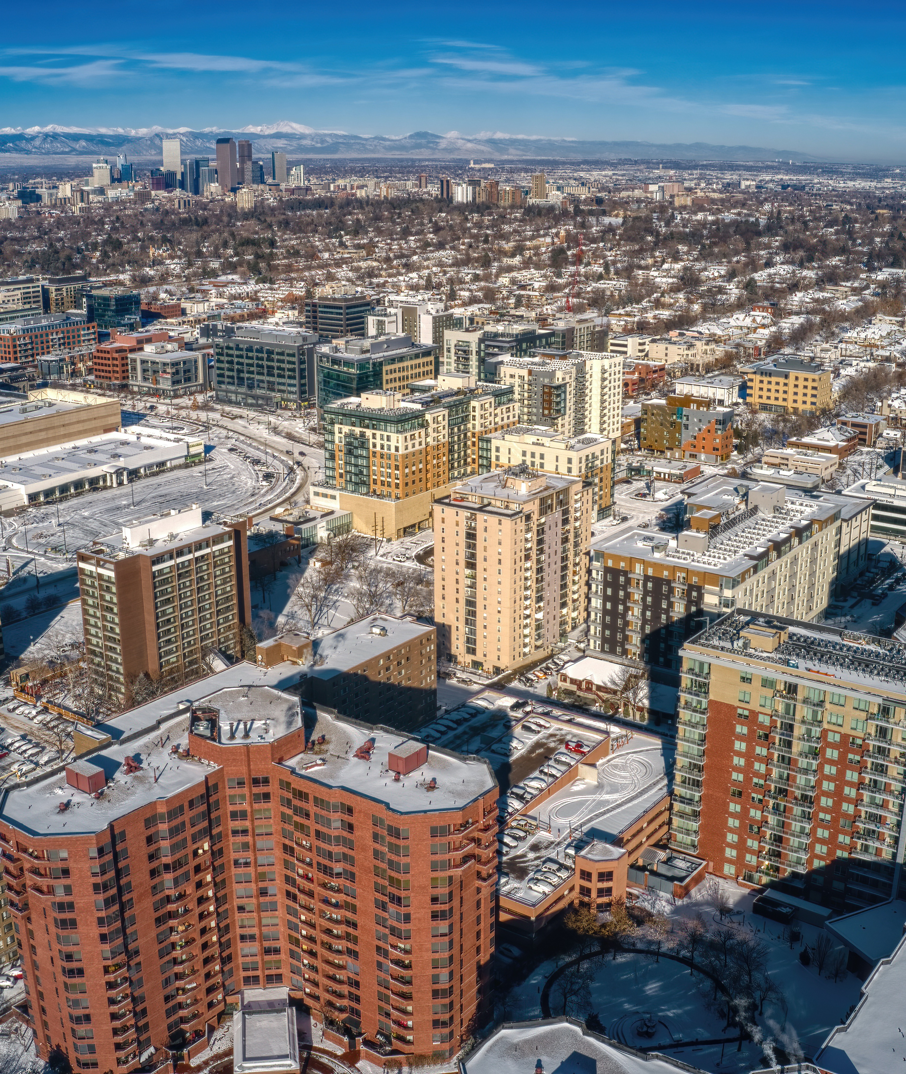
We live regional lives
We don’t choose our homes based only on city boundaries – we choose based on what matters to us:
  Being close to work
  What we can afford
  Good schools
  Amenities like parks, transit, or entertainment
  Access to childcare
And many of us work, go to school, shop, and visit friends and family across the region.

Slide 16


Where we live affects other issues we care about
Traffic – the less we have to drive, the less traffic congestion we will have
Climate and Air Quality – less driving also means fewer emissions
Equity – diverse housing options support more inclusive communities
Economic Vitality – homes close to jobs that workers can afford help our businesses and communities thrive

Slide 17
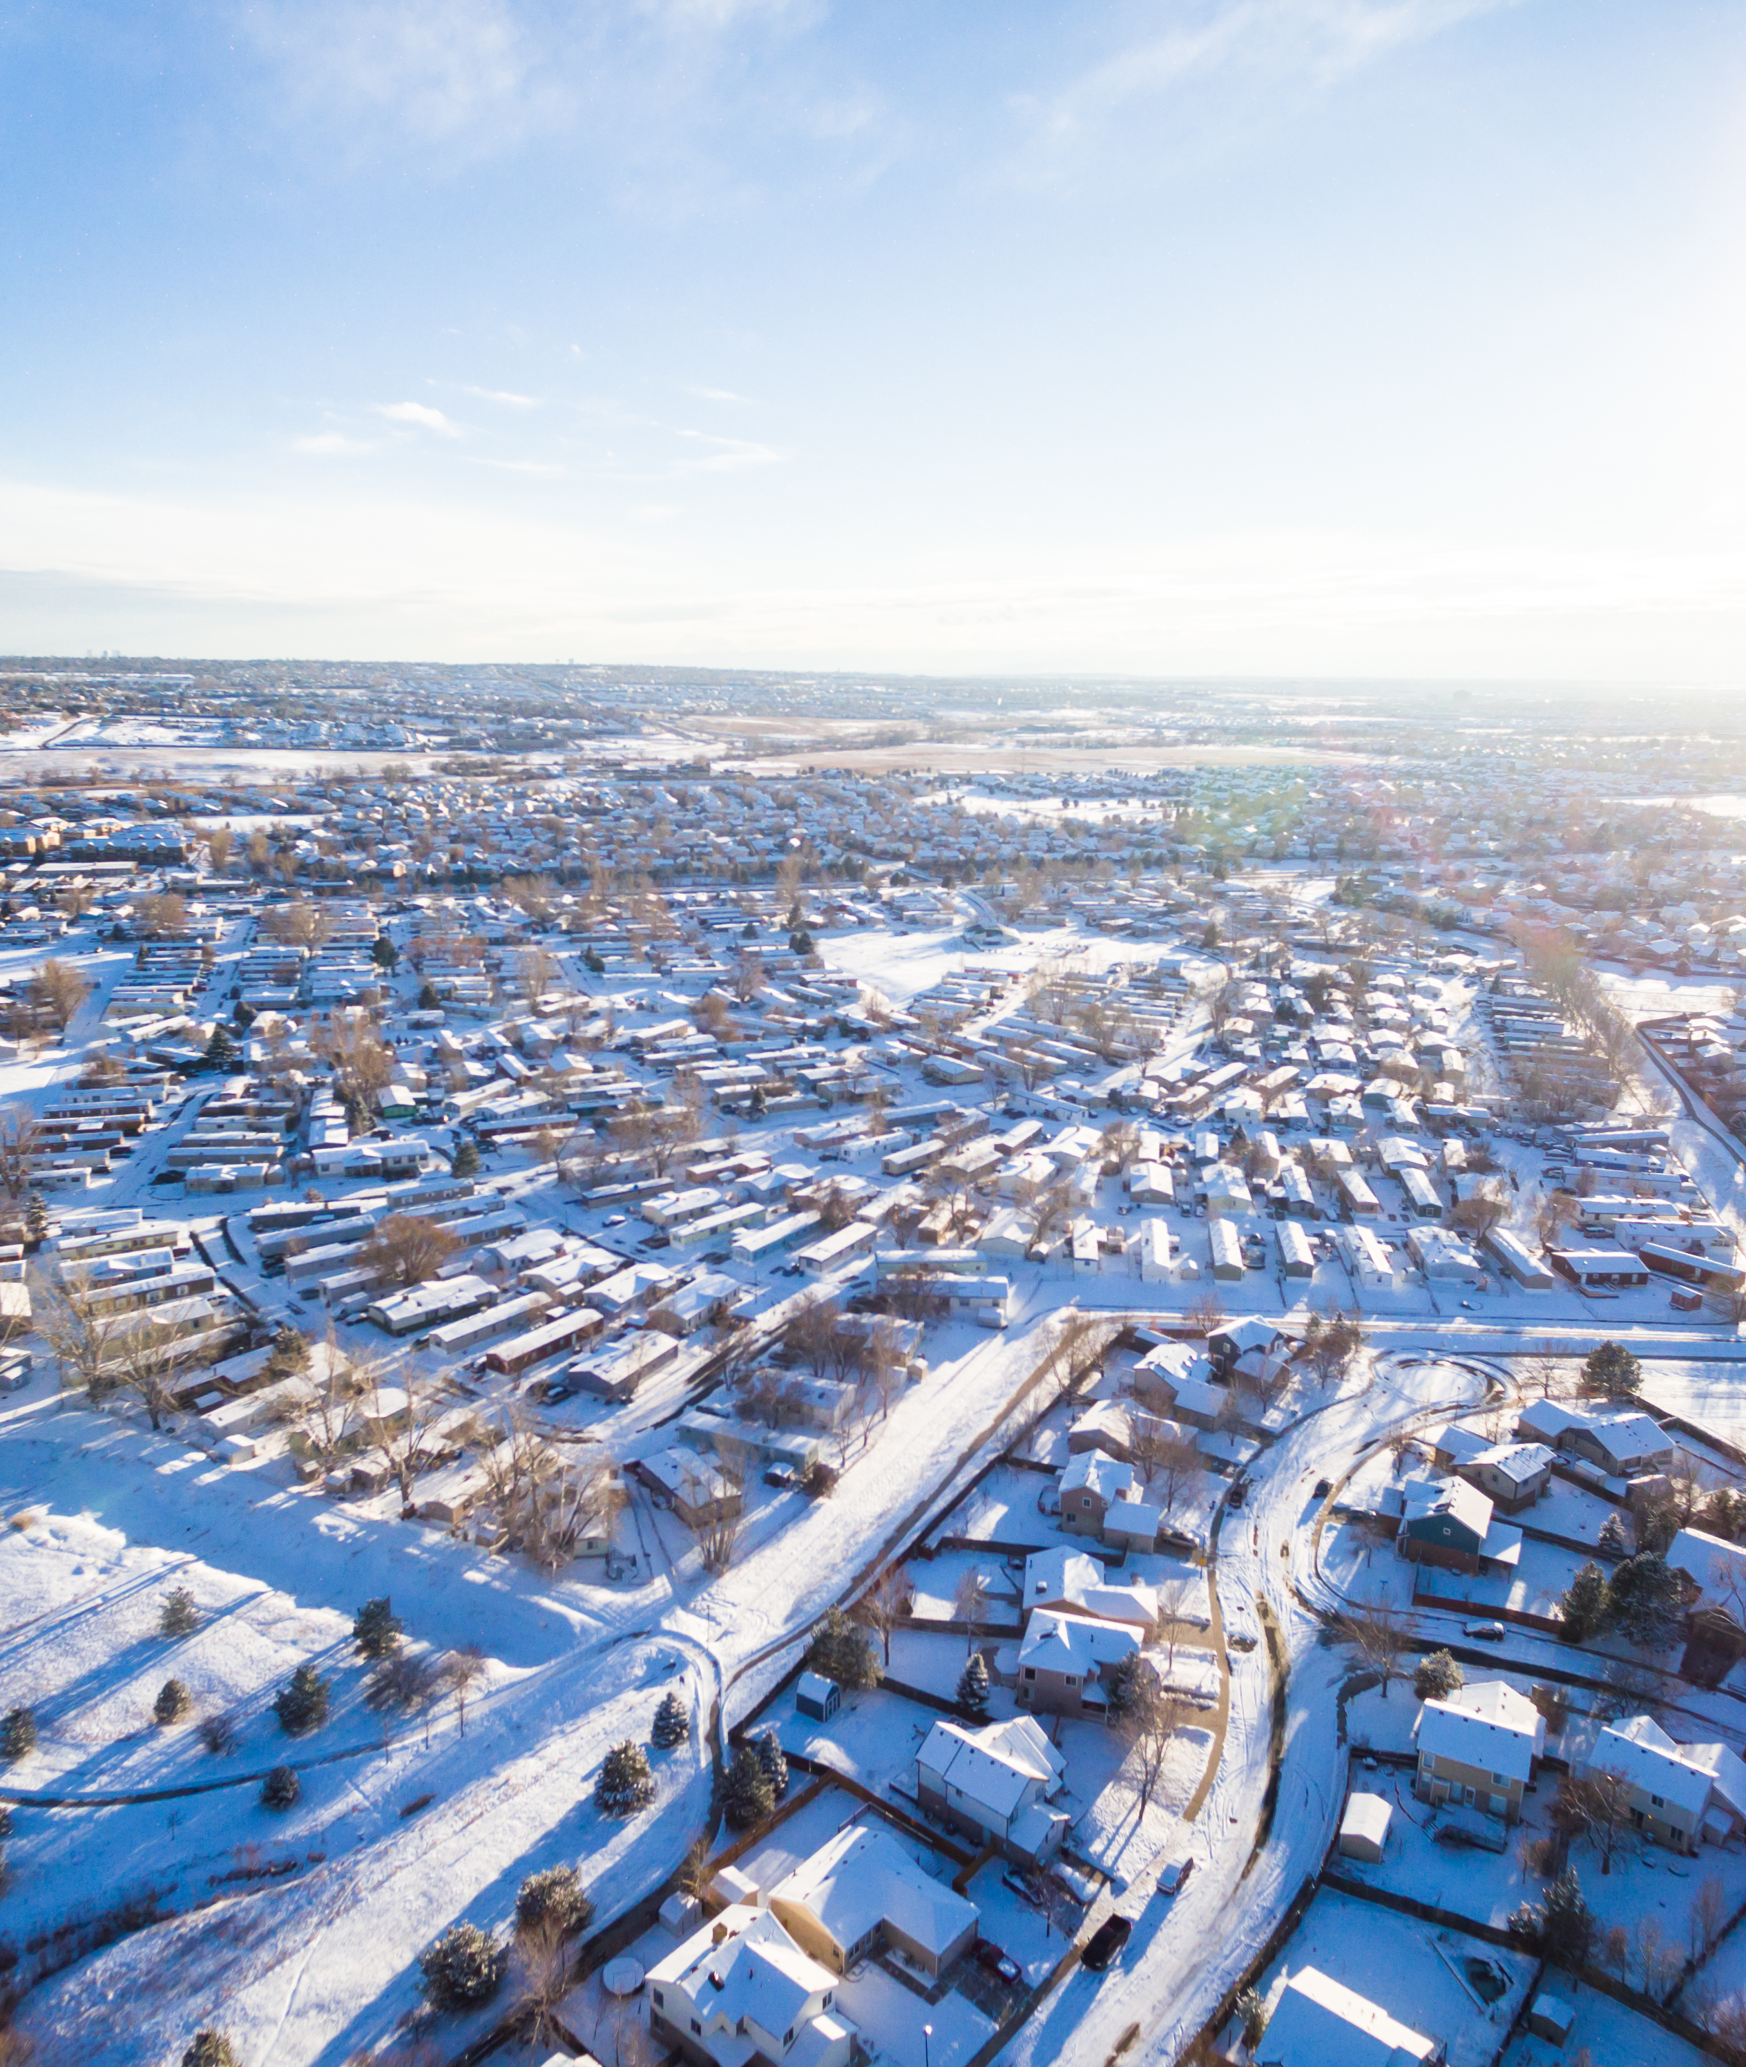
All of the communities in our region face housing challenges
While every community is unique, we are all facing challenges in meeting our housing needs
The ways in which homes are financed and built is similar across our region, including things like labor and material costs
Housing affordability is an issue that affects us all

Slide 18
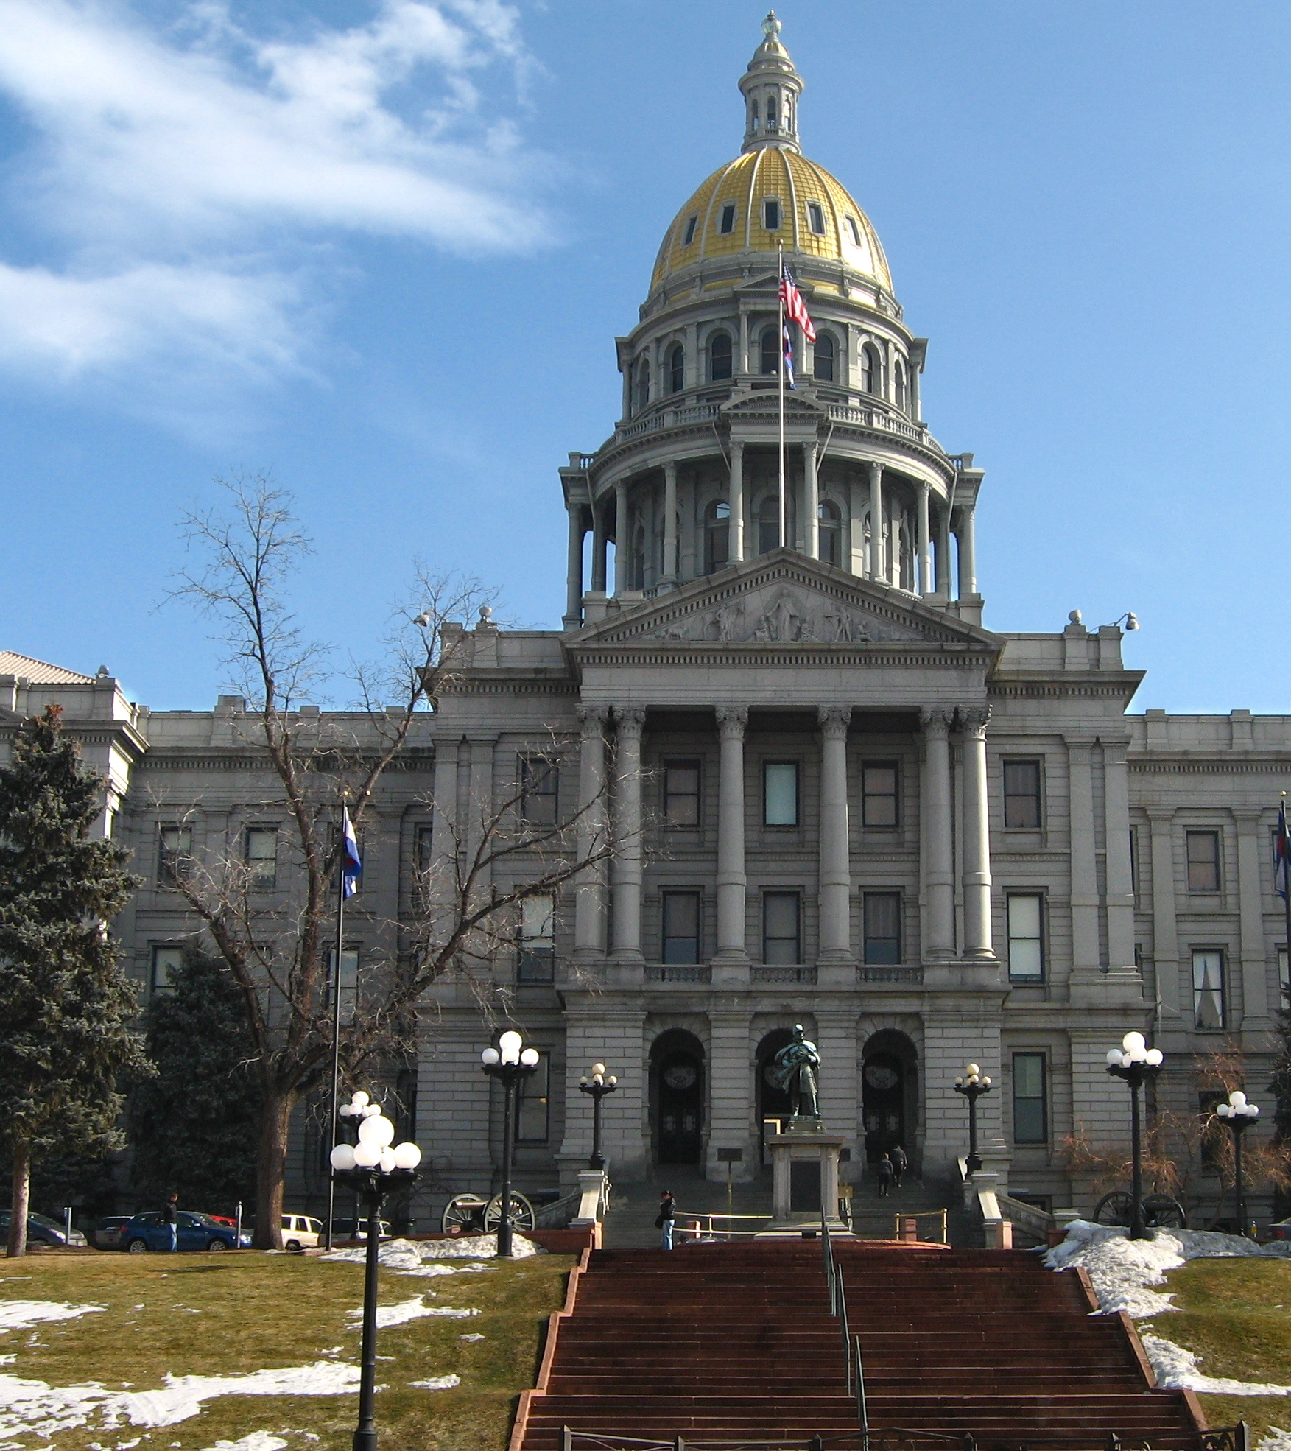
Housing is a major focus for the entire state.
The Colorado legislature has passed bipartisan bills in recent years to support the creation of more housing.
The Governor’s office and state agencies are providing incentives and assistance for local governments working to increase housing opportunities.

Slide 19
We can be more effective if we work together
Local
Governments
Learn from each other and explore new approaches to shared challenges
Leverage resources and do more with less
Bring together home builders, community groups, finance experts, nonprofits and local governments
Strengthen our regional ecosystem to achieve the change we want to see
Financing
Experts
Builders
Community
Groups
Nonprofits

Slide 20
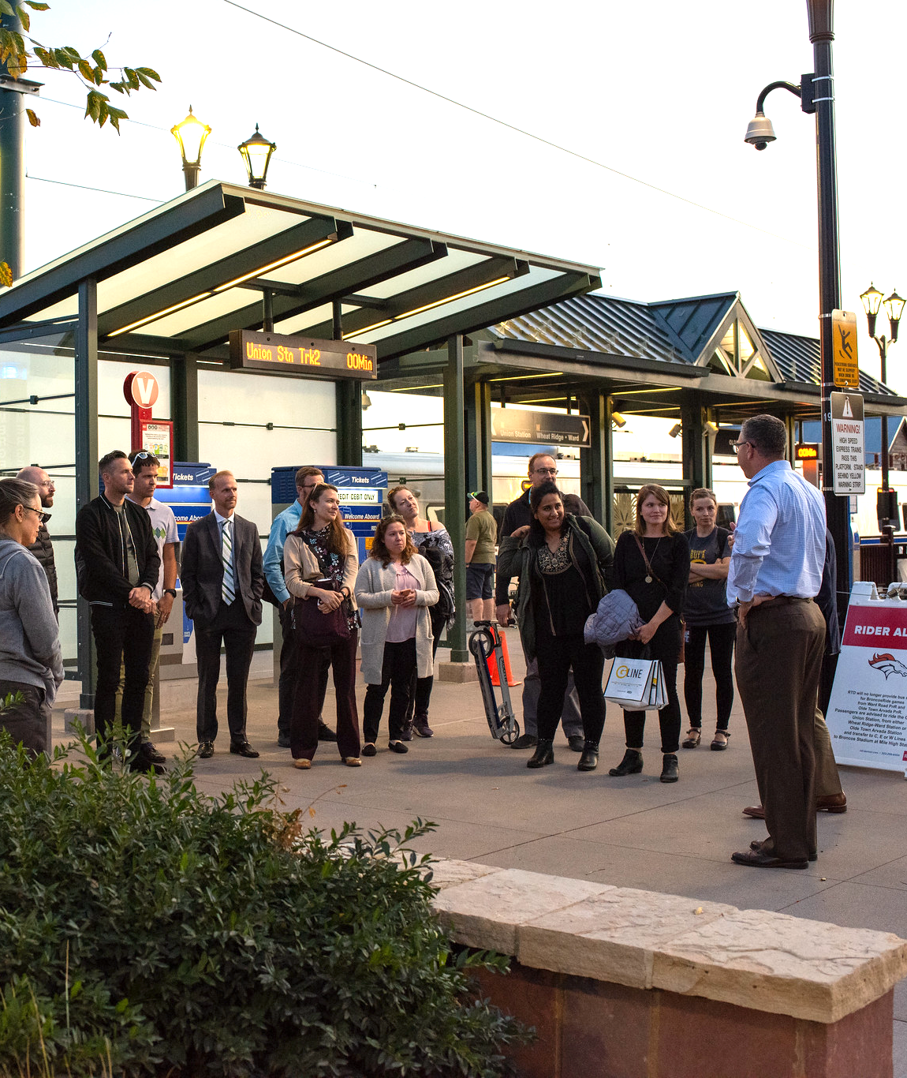
A regional strategy can support local action and collaboration
By working together, we can get more done and make a bigger difference
Coordinating efforts allows us to plan for housing in ways that reflect the needs of our local community as well as the region
When communities work together, we can share ideas and resources and create better, smarter solutions

Slide 21

Working toward a regional housing strategy
DRCOG completed a Regional Housing Needs Assessment to understand the shared housing challenges our region faces.
We are now working together to gather information on housing efforts across the region to better understand what is working, what isn't, and what's missing
People across the region are giving input to shape the outline of a regional housing strategy: what we want to achieve and how we can best work together

Slide 22
NOTE TO USER:
Consider adding a slide or two about the recent, current or upcoming work you are doing to address housing needs in your community.

Slide 23

It's 10 years from now and our region is seen as a national model for communities working together to address housing needs.
We want to hear from you!
What did we do that made the biggest difference? What outcomes are you most proud of?

Slide 24


Learn More!
We can create the future we want by working together.
      Learn more about the
      Regional Housing Needs Assessment
      Learn more about the
      Regional Housing Strategy
      [Note to User: add other relevant links]

Slide 25
Thanks for joining the conversation
Your voice matters in shaping solutions. Please stay involved!
Questions?
Contact [FILL IN LOCAL CONTACT]

